Slide 1


Slide 2
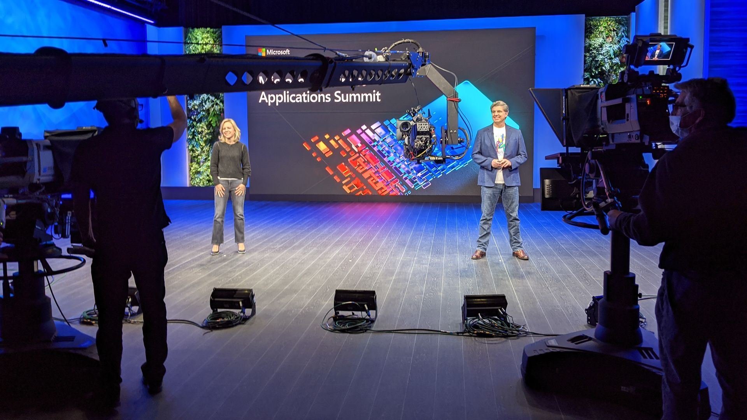
https://mymbas.microsoft.com/

Slide 3
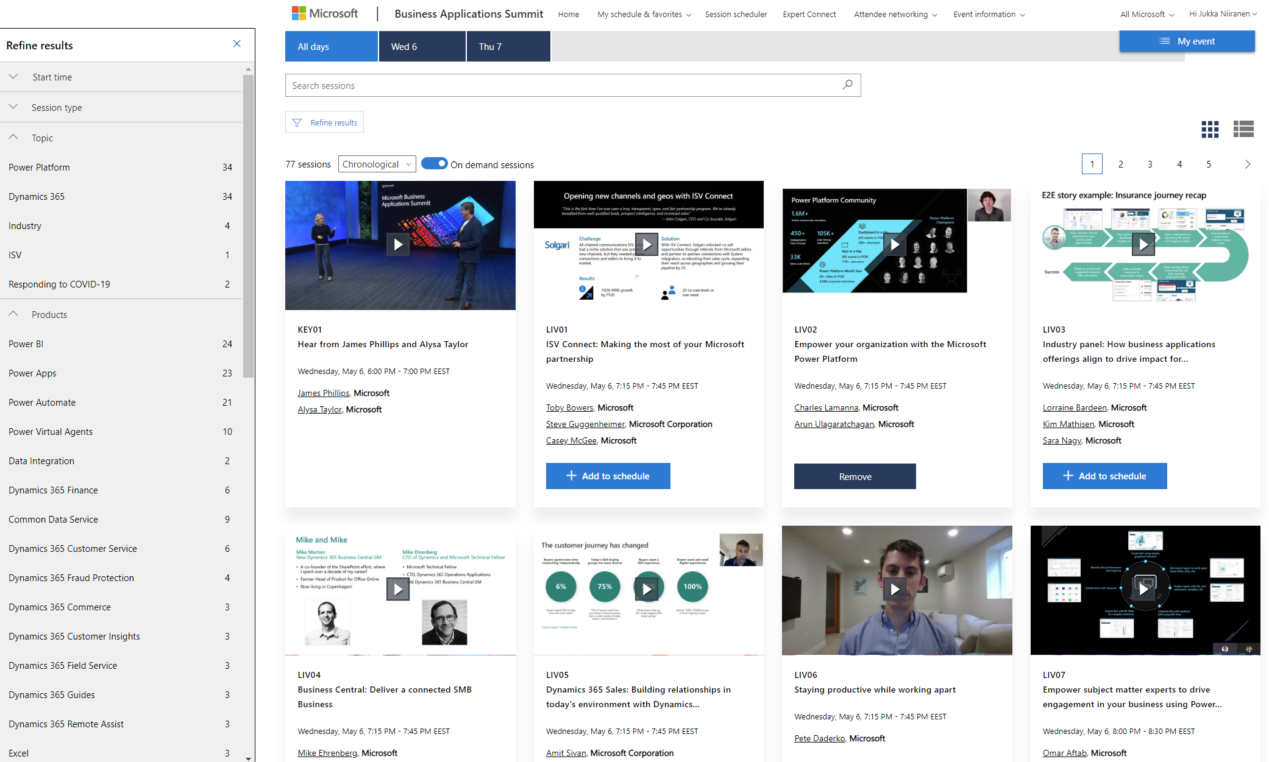

Slide 4

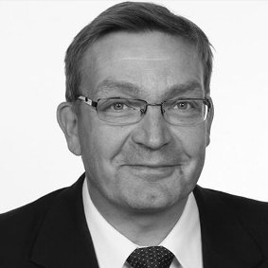


MBASin parhaita paloja
@jukkan
Keynote demo: IKEA
Power Platform / Jukka Niiranen
Teams / Markku Suominen
“Model-driven apps in Dynamics 365” (a.k.a CE) / Antti Pajunen
Finance & Operations / Teemu Miettinen
@markkusuominen
@teemupmiettinen
@anttipajunen

Slide 5
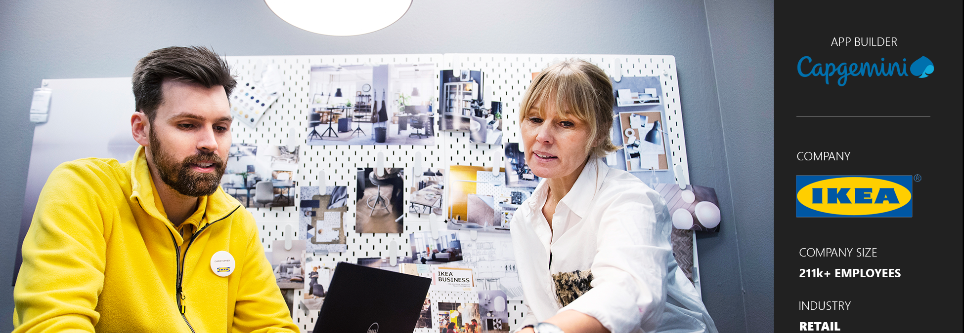
Customer story: IKEA
https://powerapps.microsoft.com/en-us/blog/ikea-sweden/

Slide 6
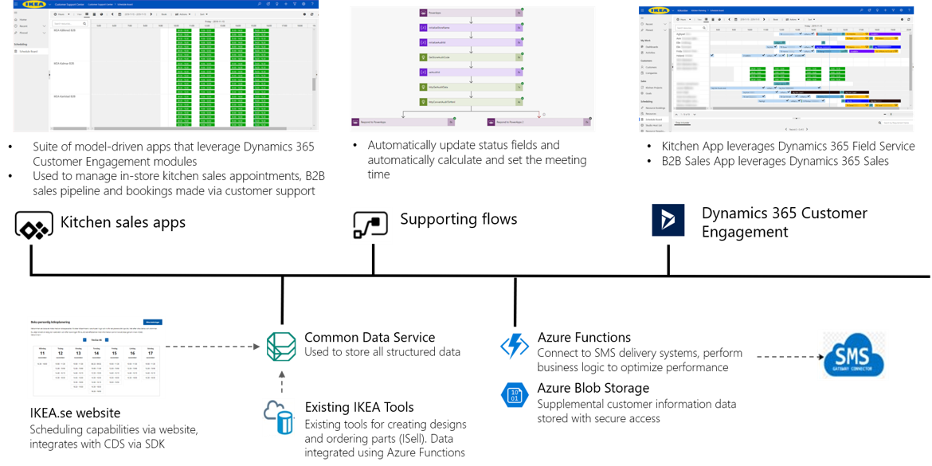

Slide 7
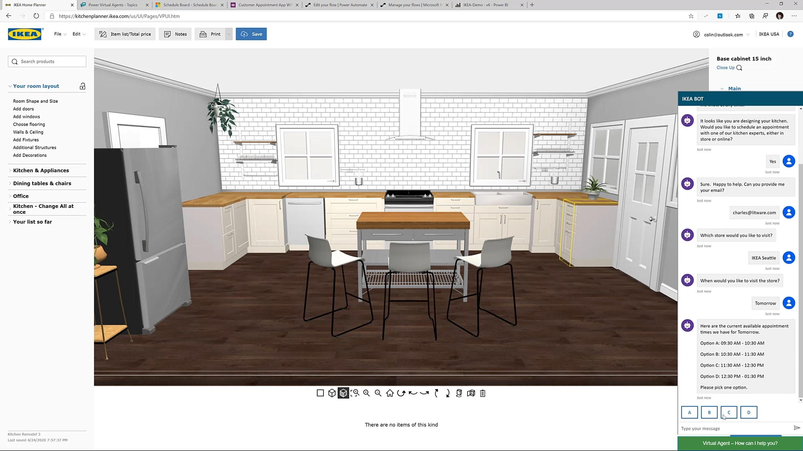
Power Virtual Agent

Slide 8
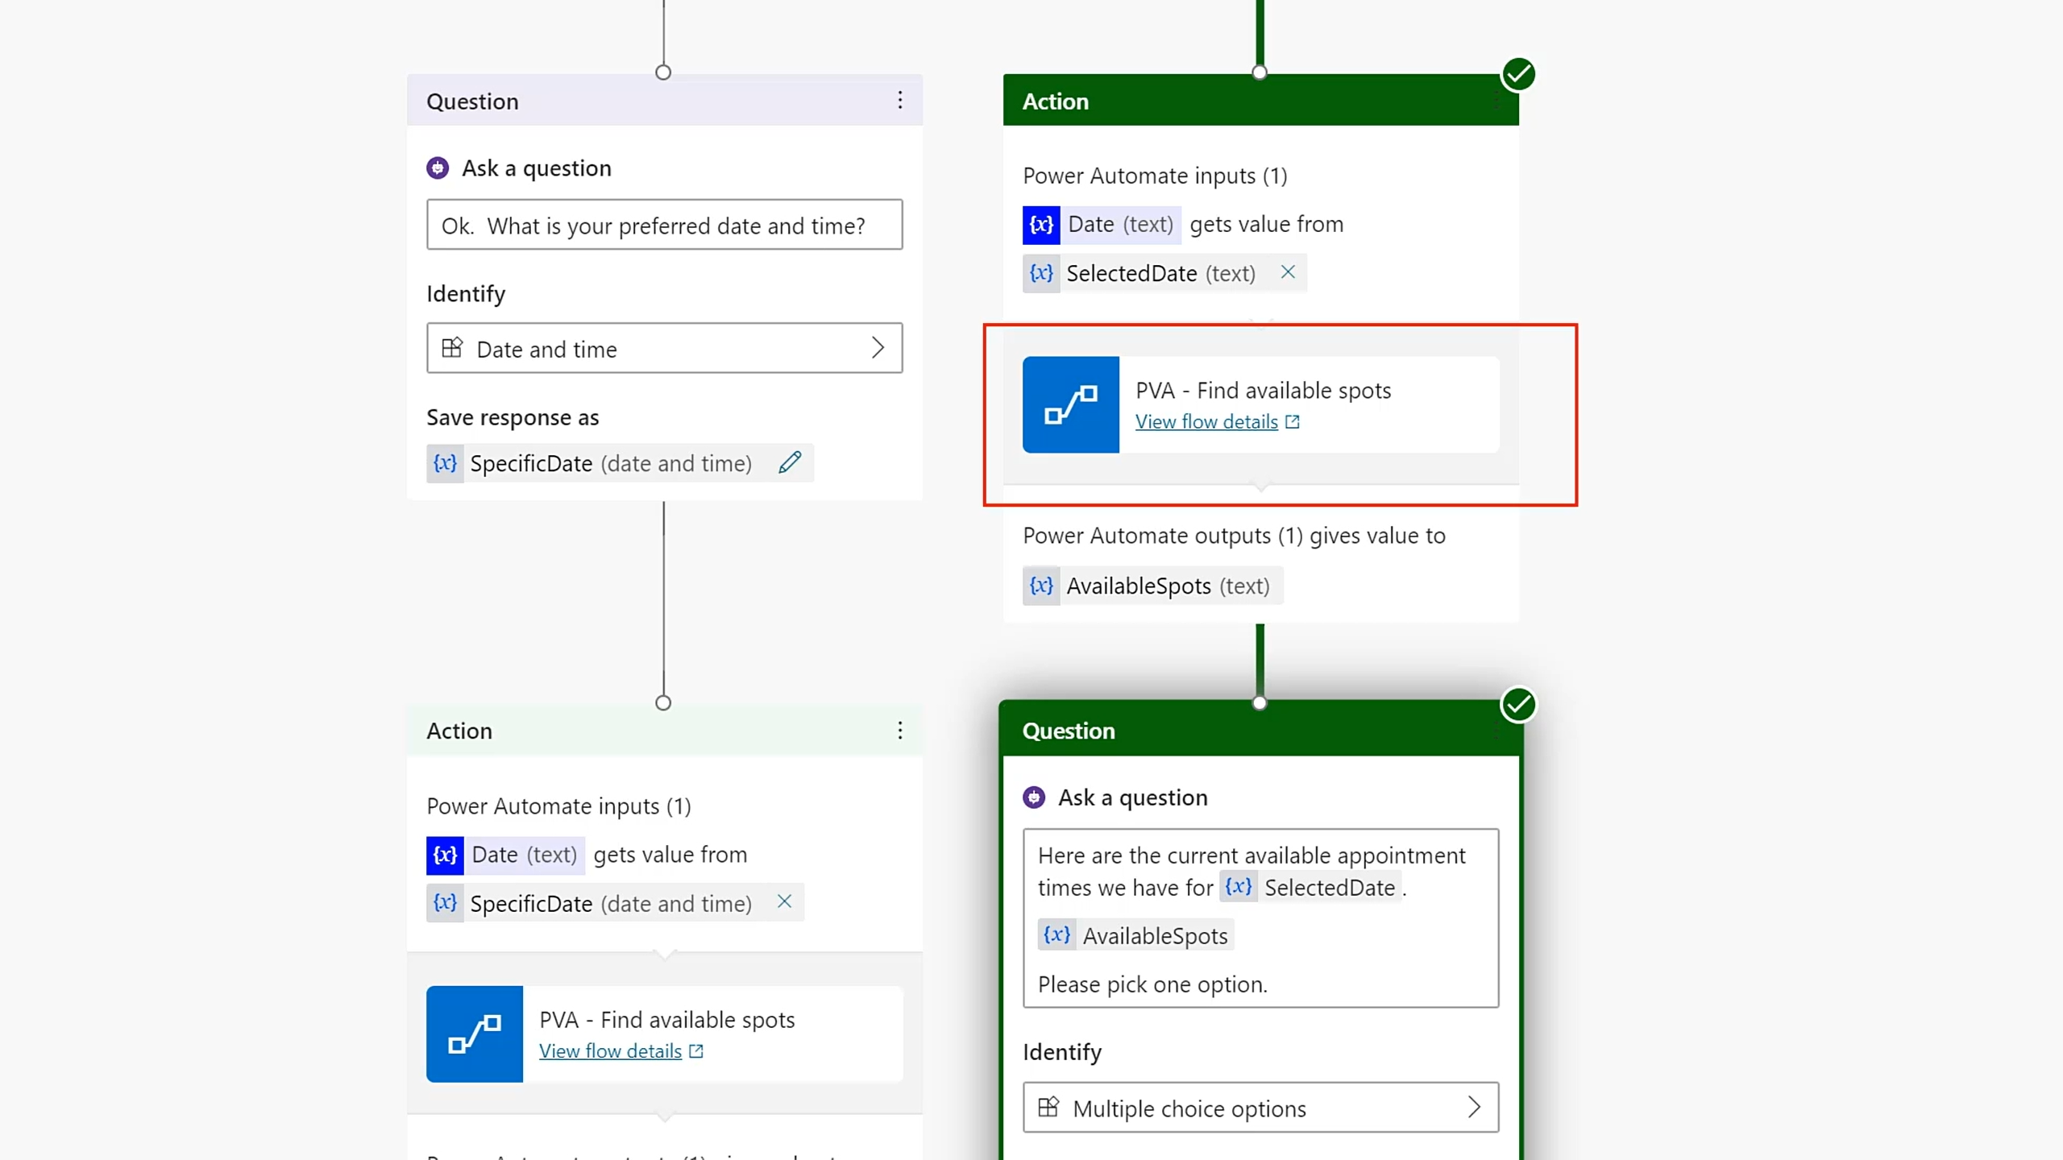
Power Virtual Agent

Slide 9
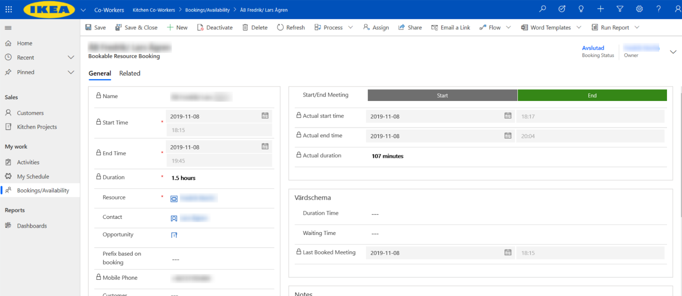
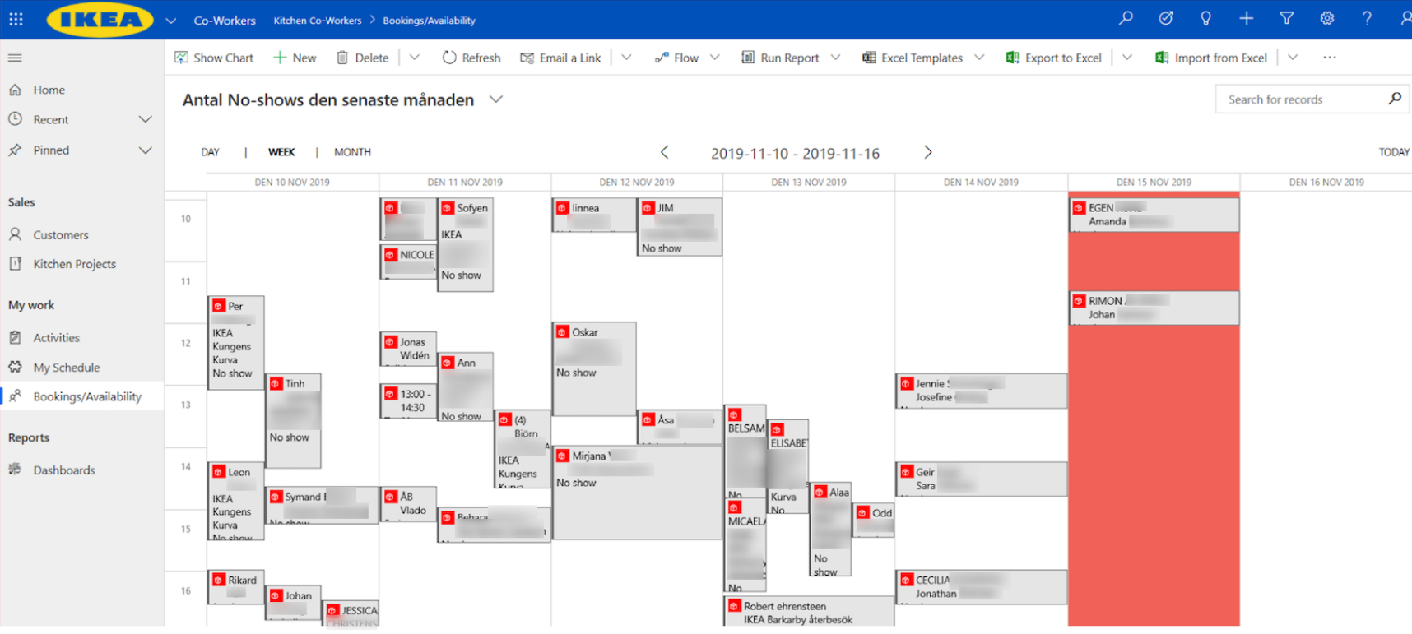

Slide 10
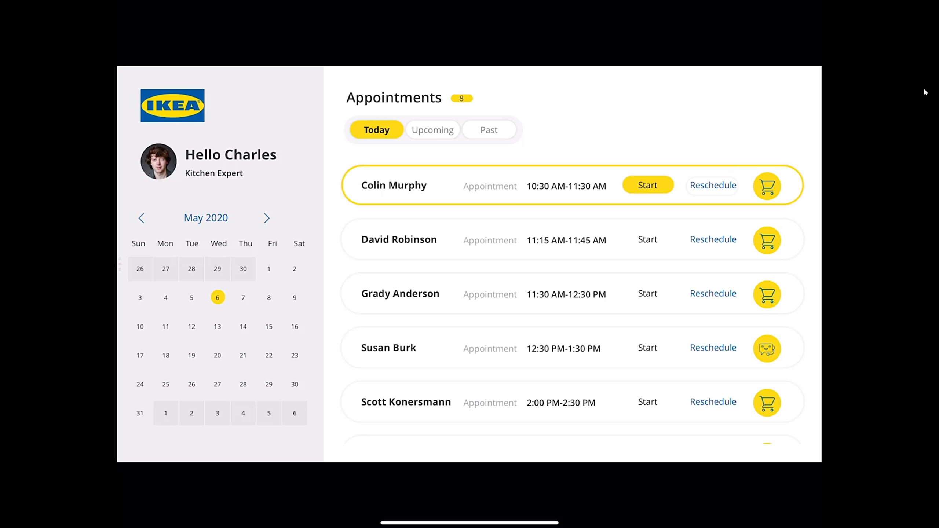

Slide 11
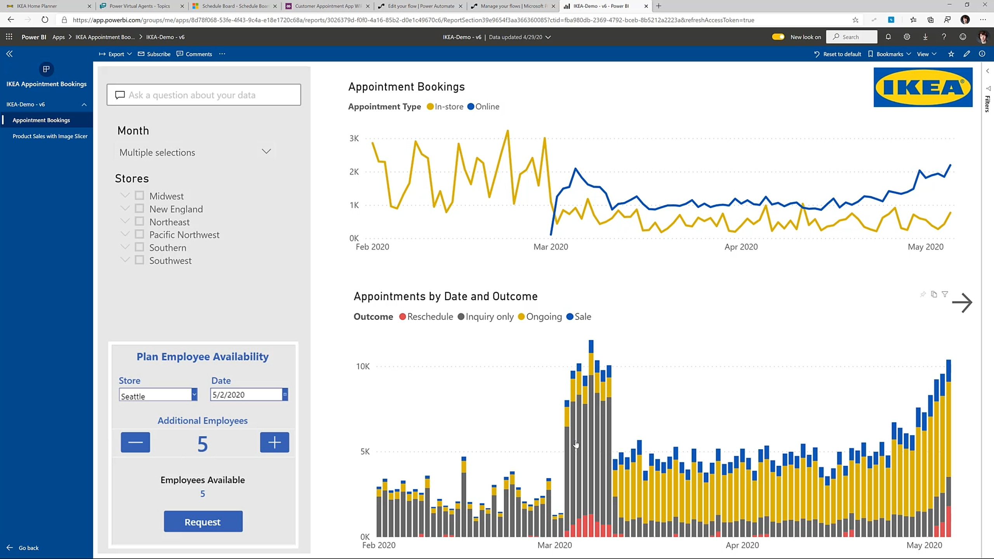

Slide 12
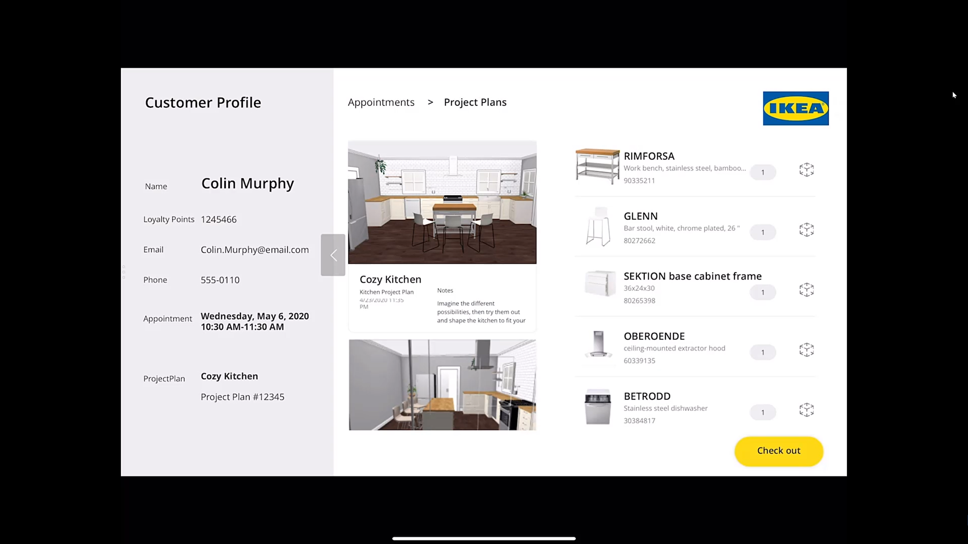

Slide 13
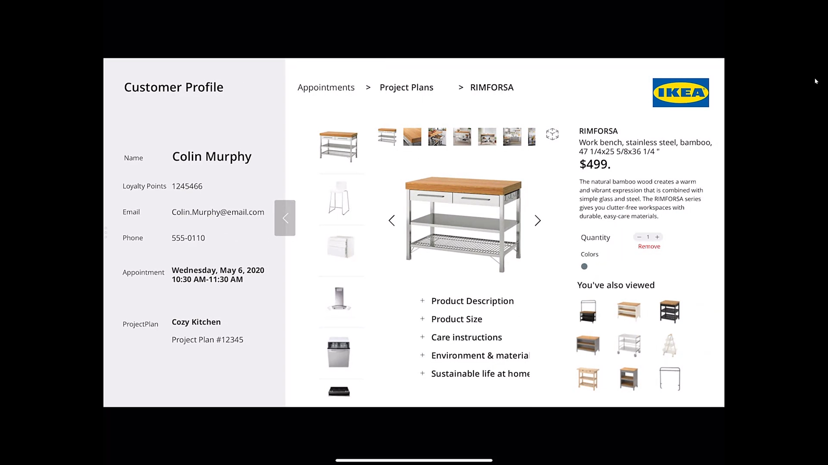
Mixed reality components

Slide 14
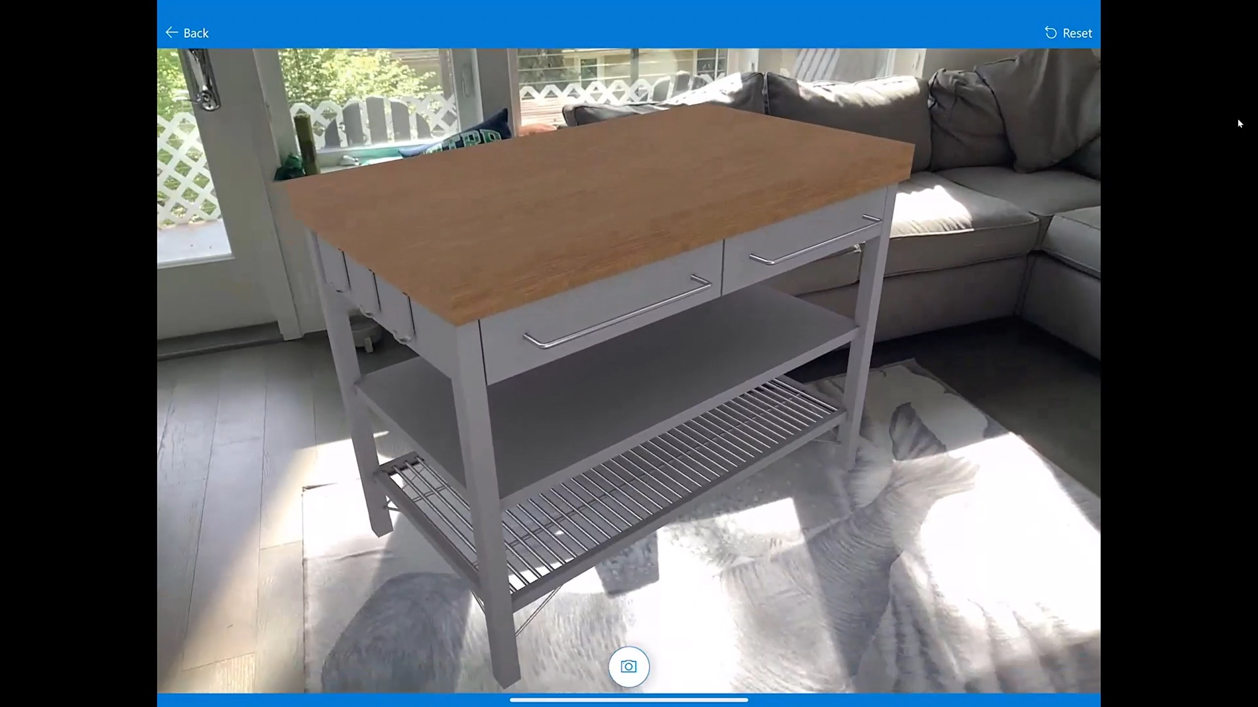
Mixed reality components

Slide 15
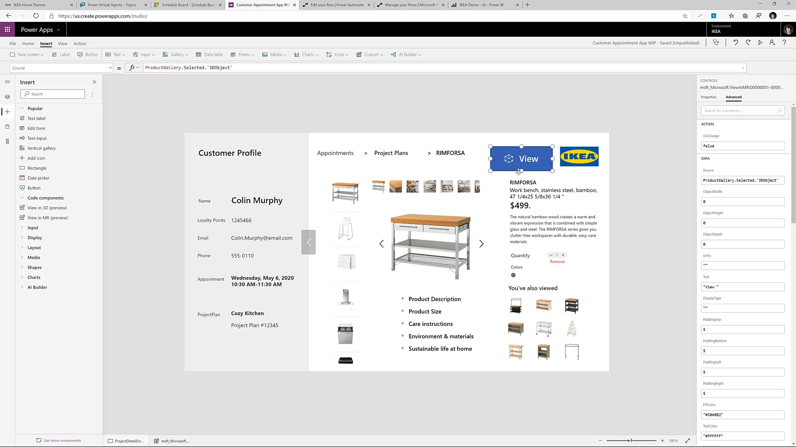
Mixed reality components

Slide 16
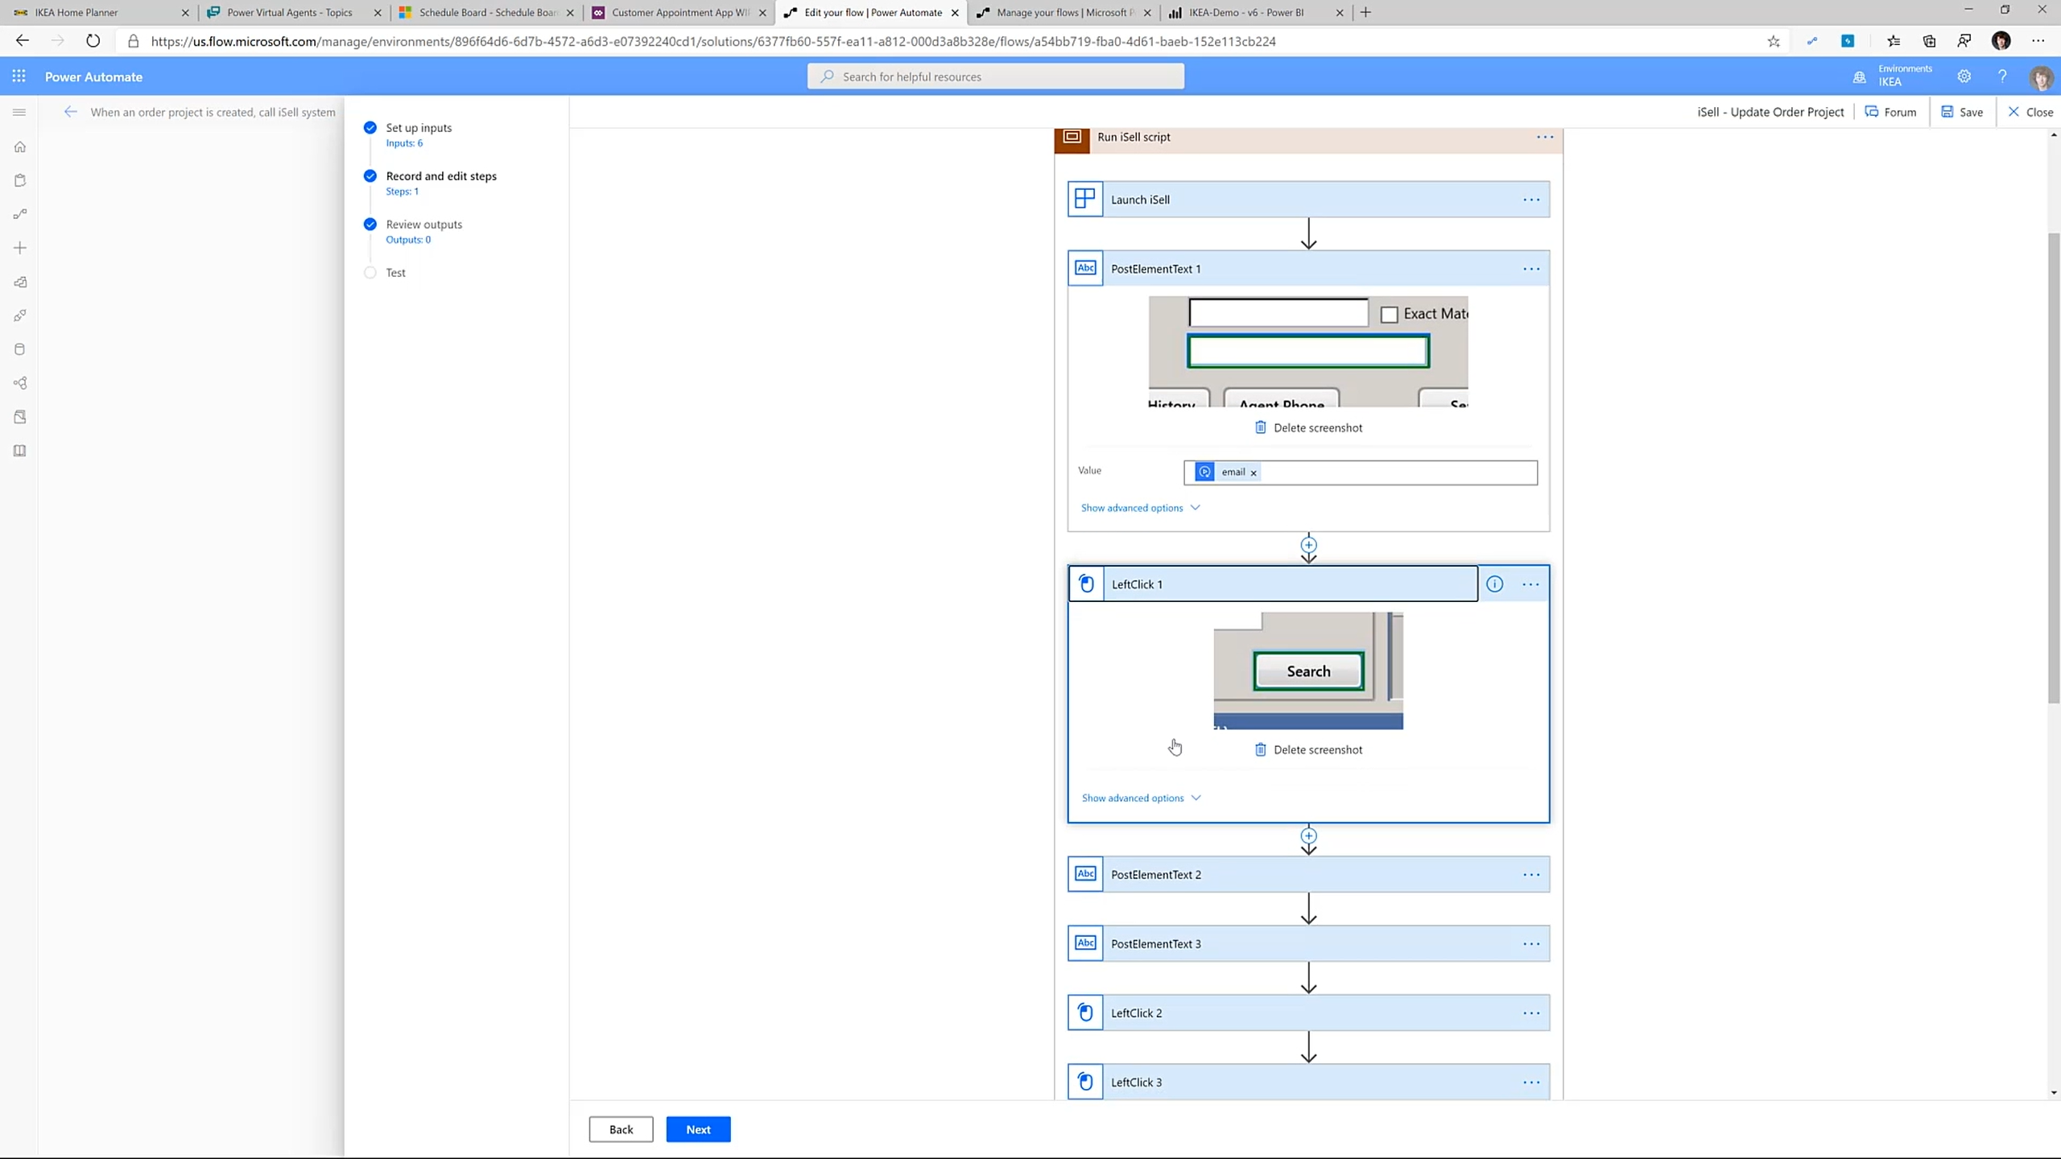
Power Automate RPA

Slide 17
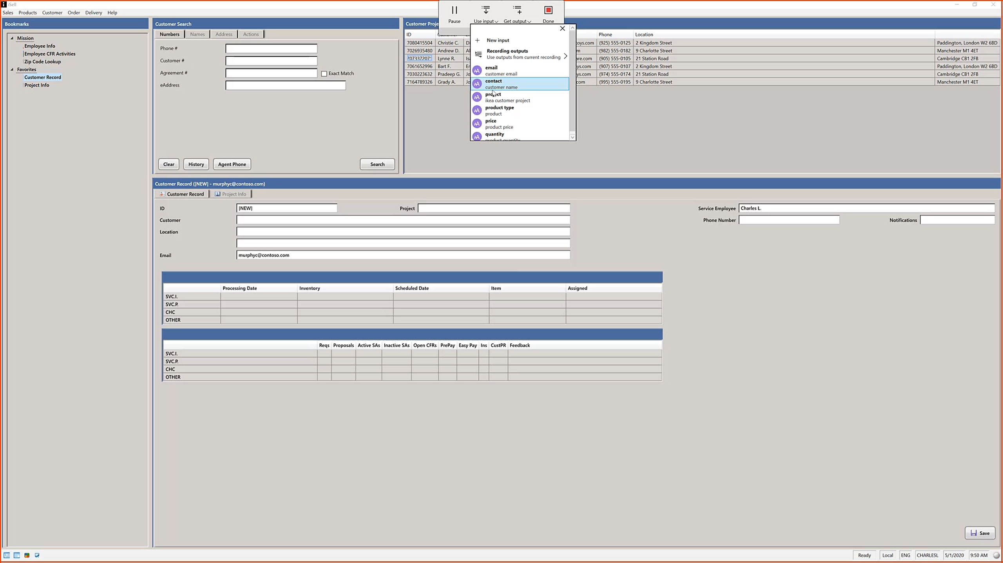
Power Automate RPA

Slide 18
Power Platform

Slide 19
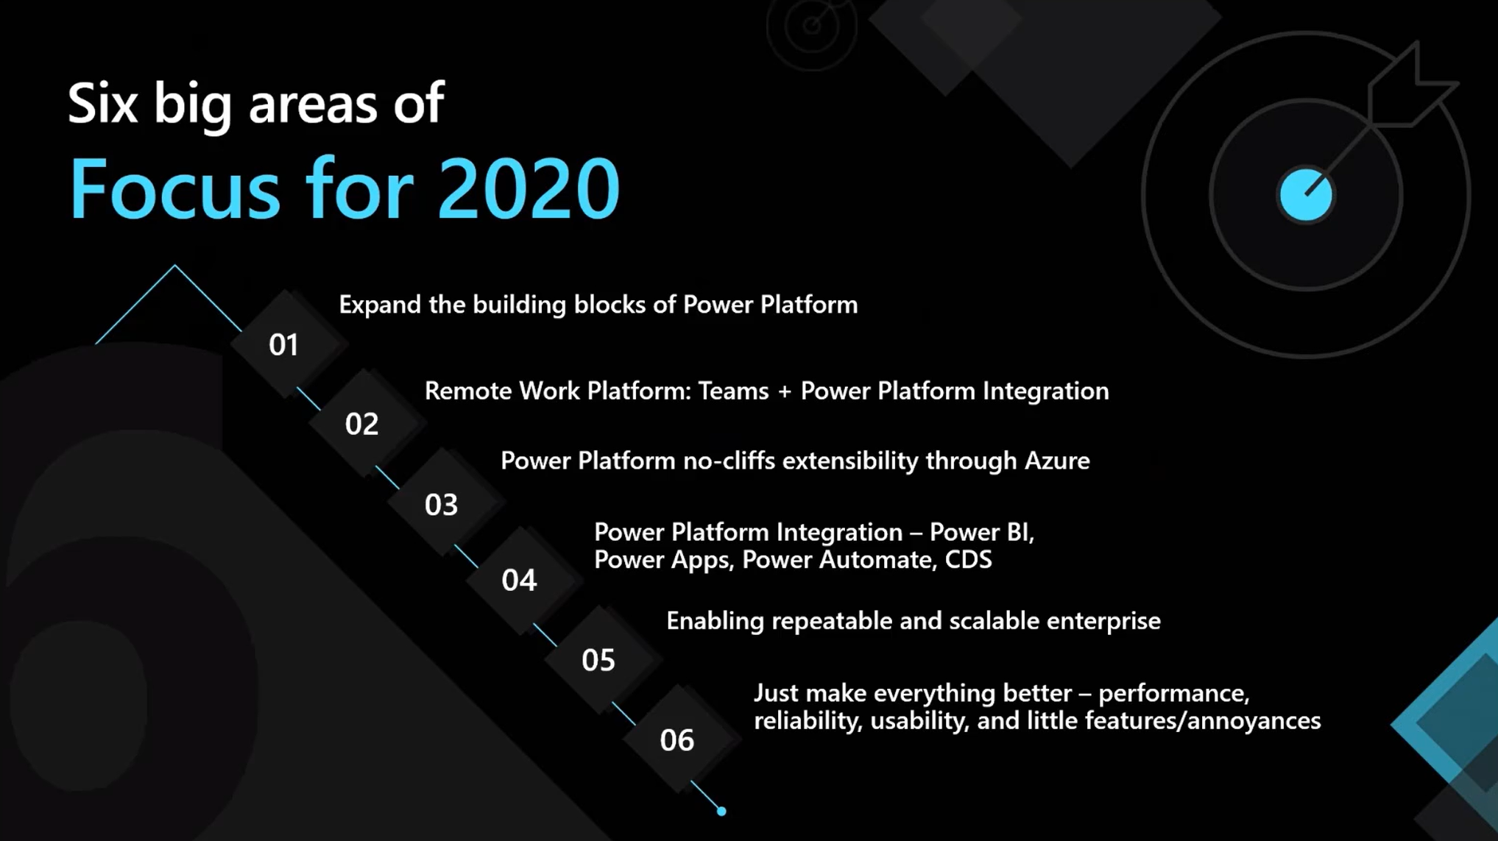
Empower your organization with the Microsoft Power Platform
Charles Lamanna: Corporate Vice President, Citizen Application Platform
Arun Ulagaratchagan: Corporate Vice President, Intelligence Platform

Slide 20
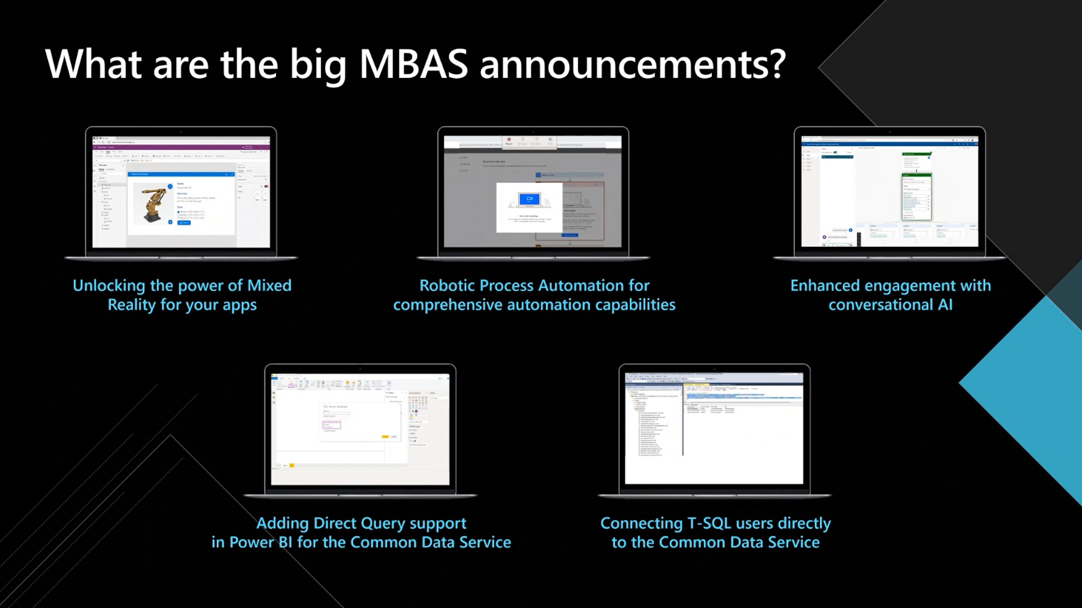

Slide 21
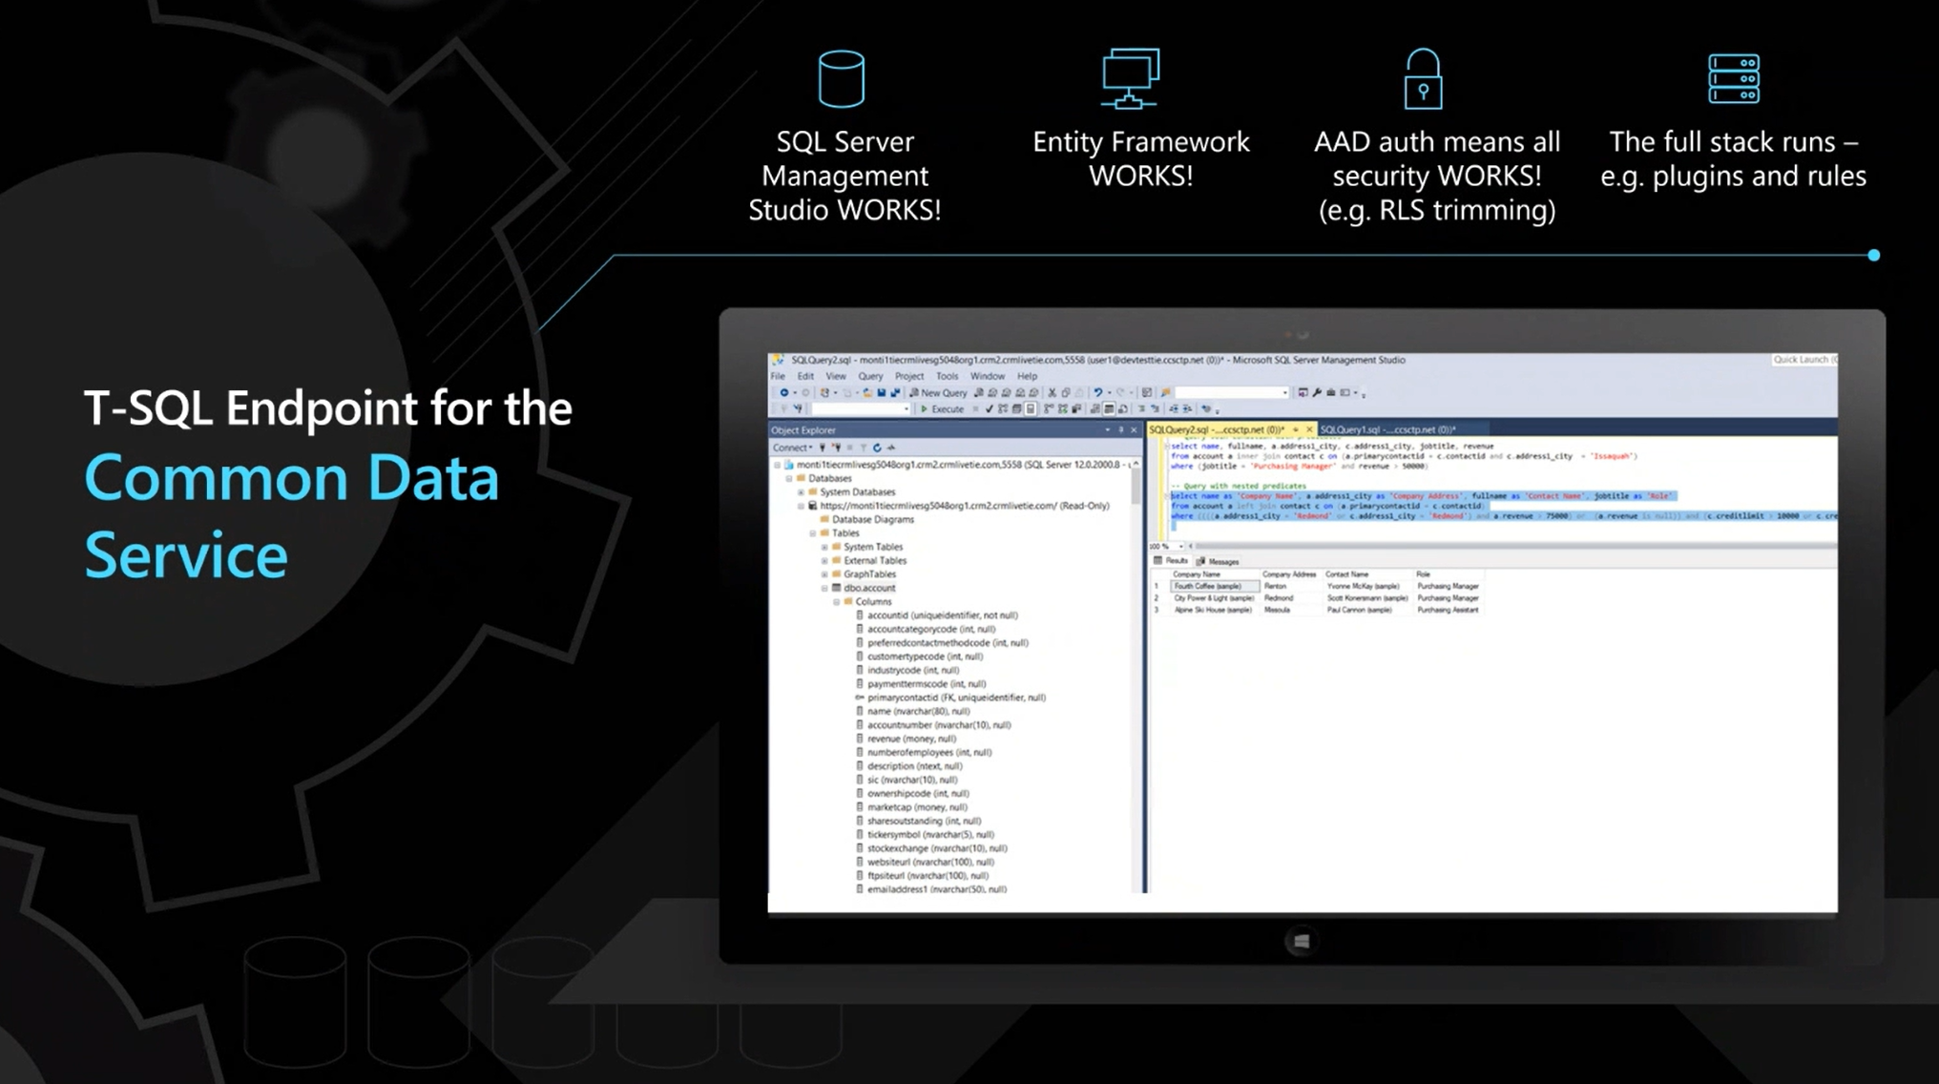

Slide 22
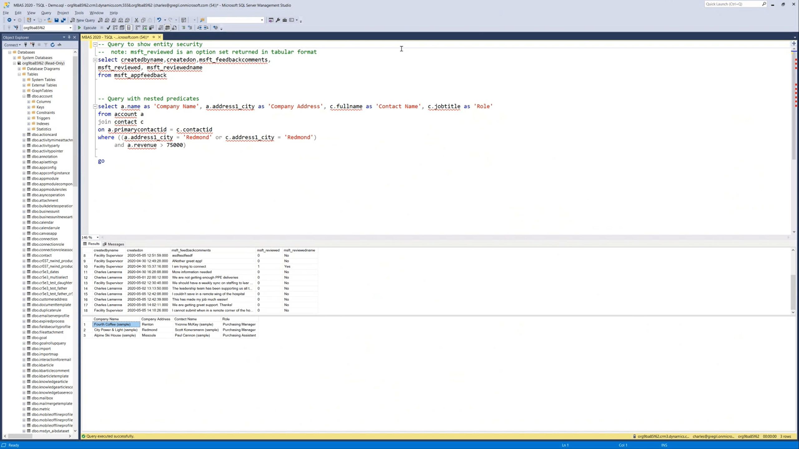

Slide 23
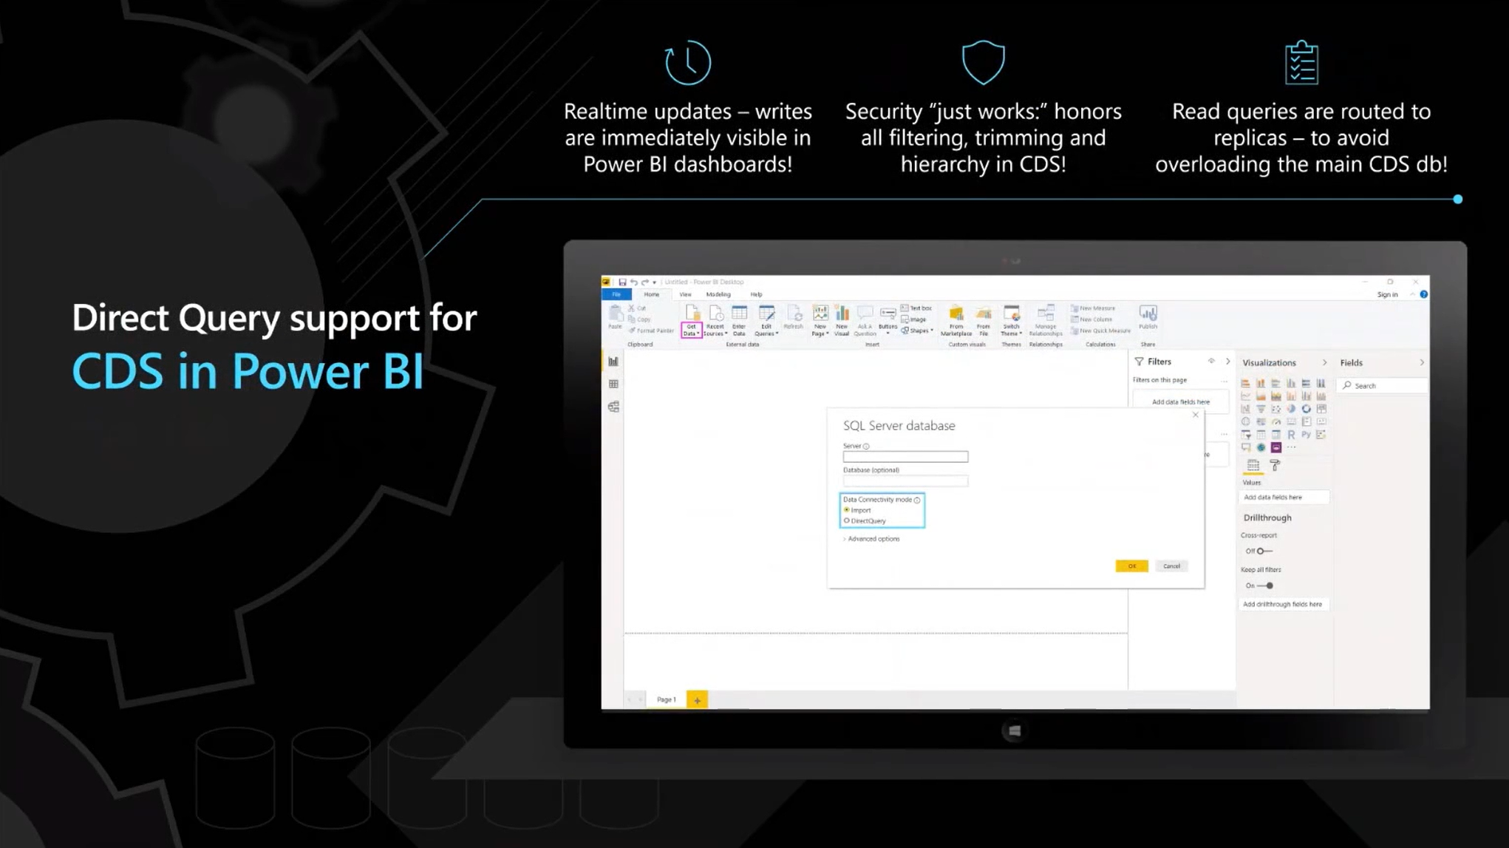

Slide 24
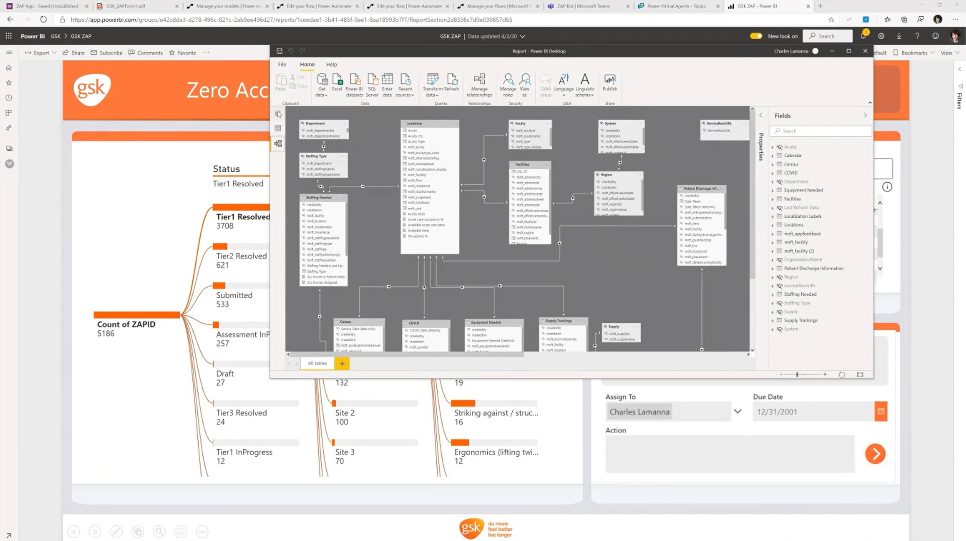

Slide 25
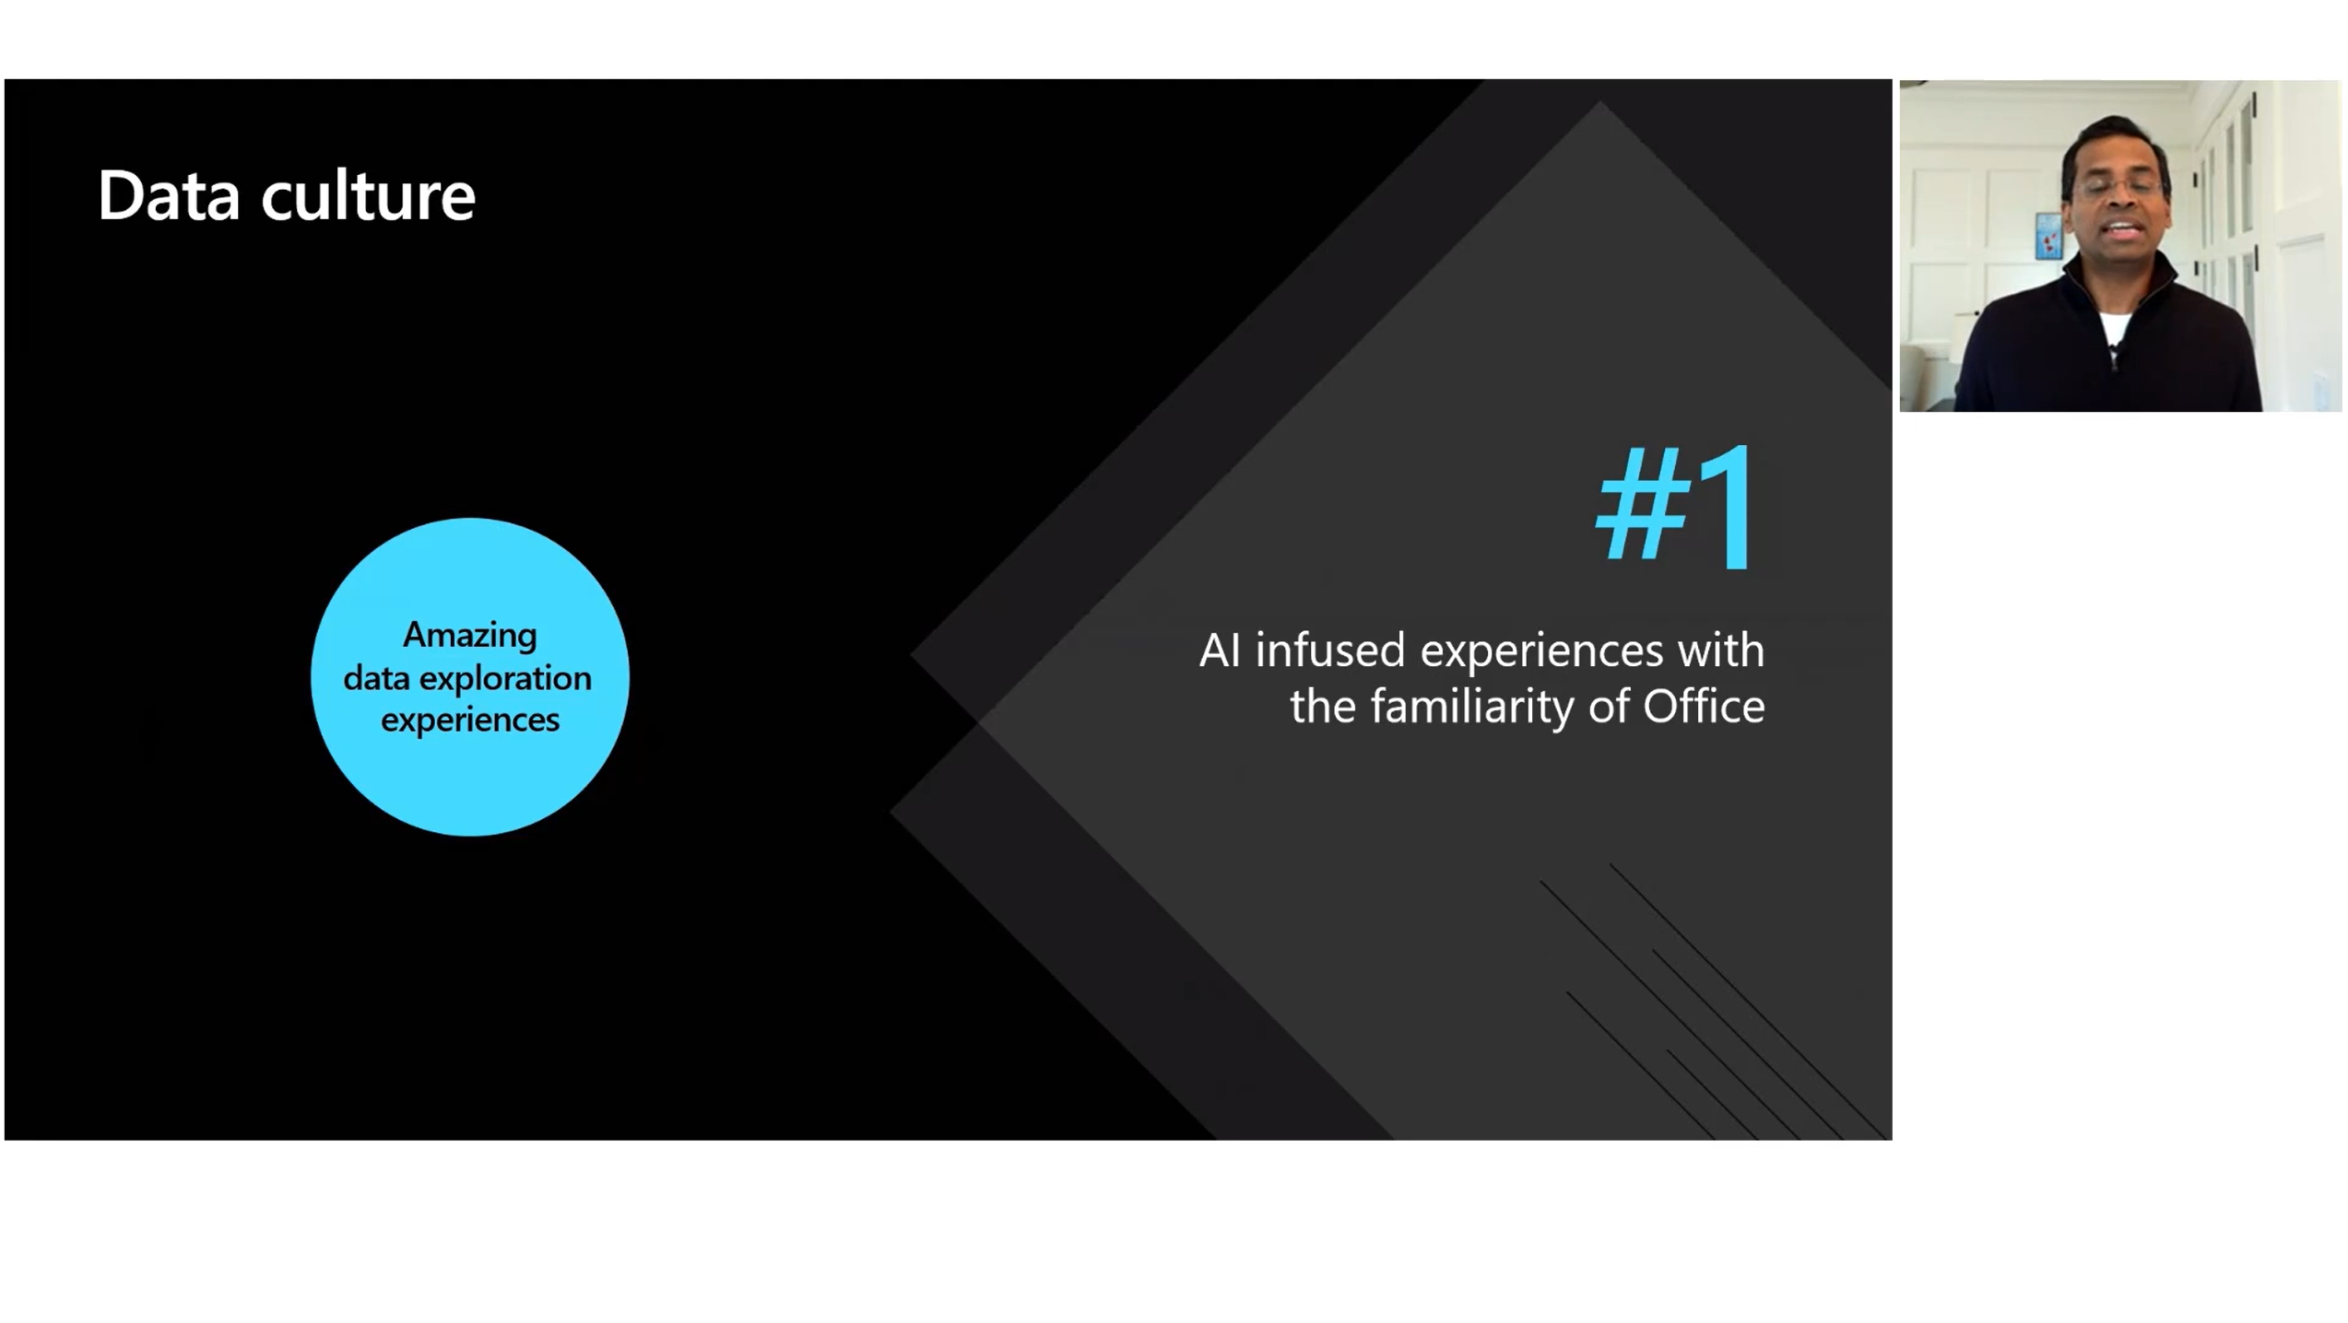

Slide 26
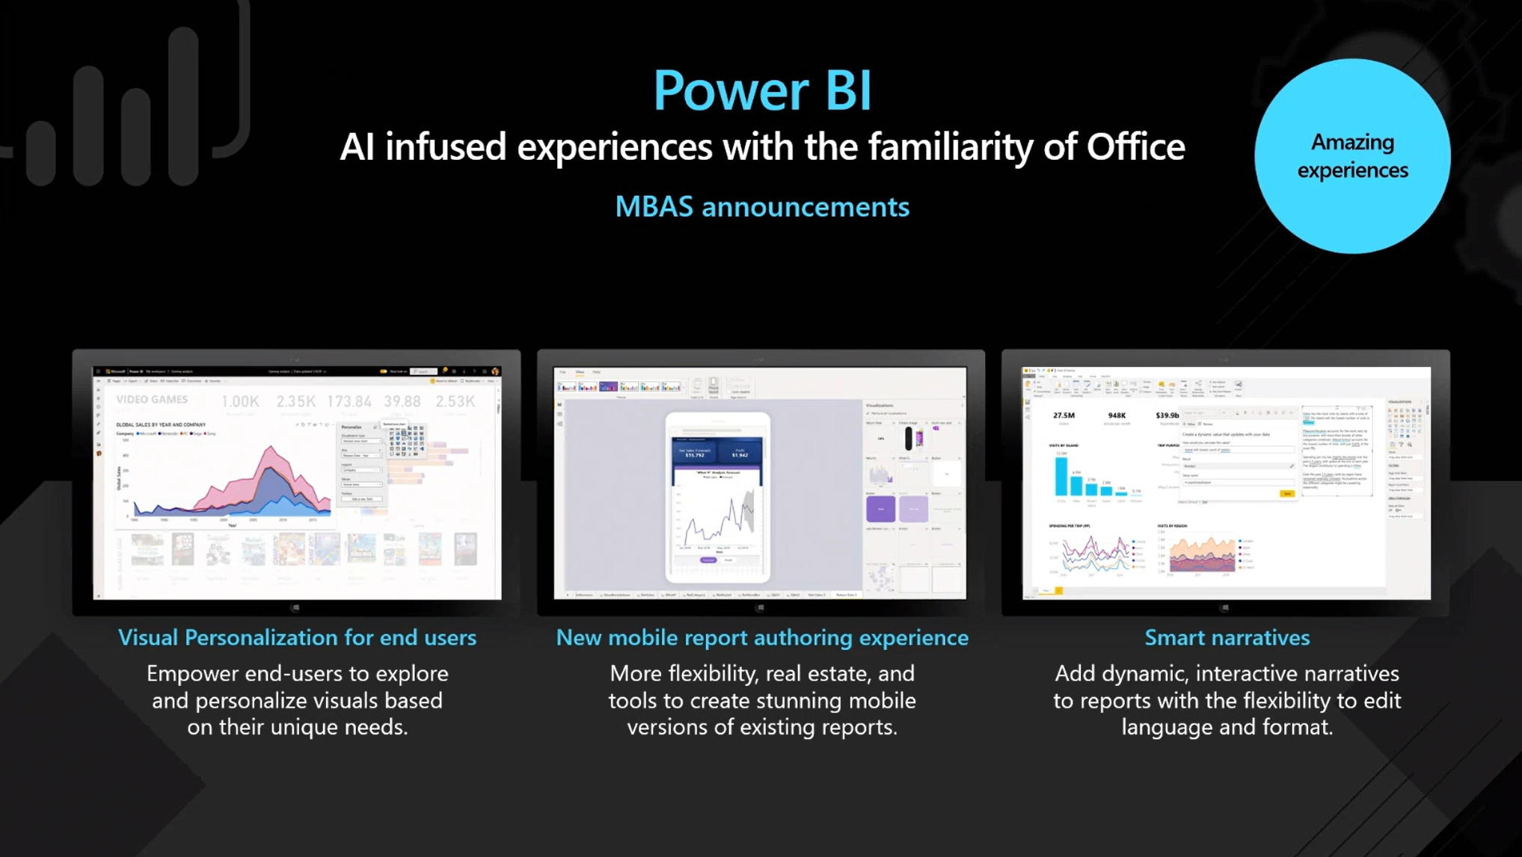

Slide 27
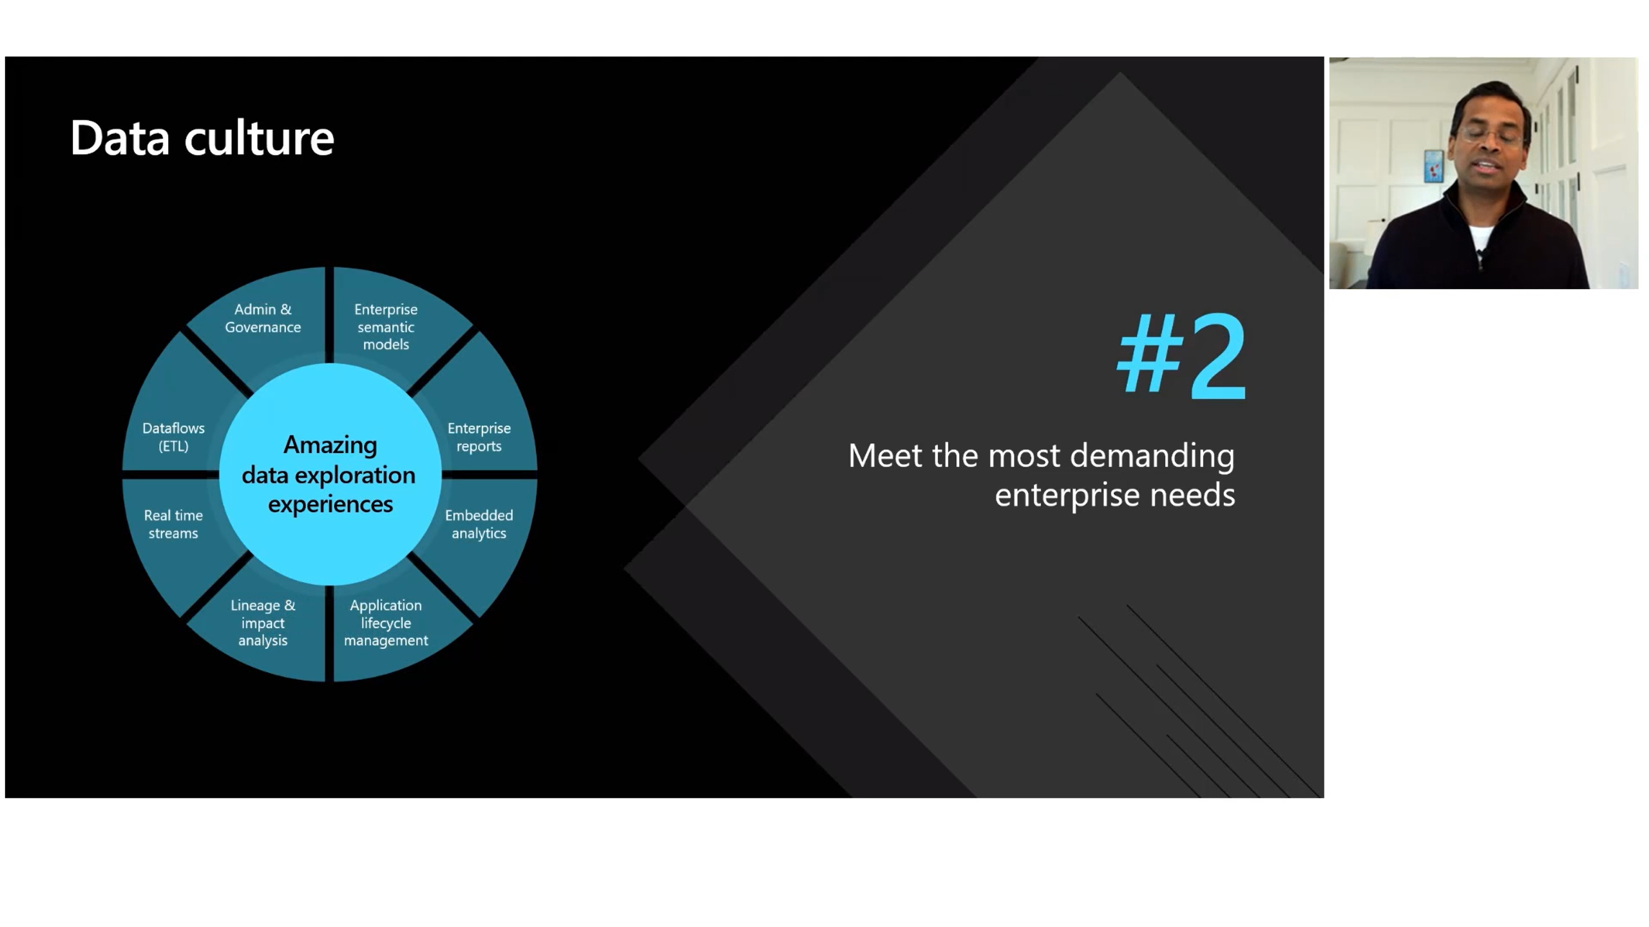

Slide 28
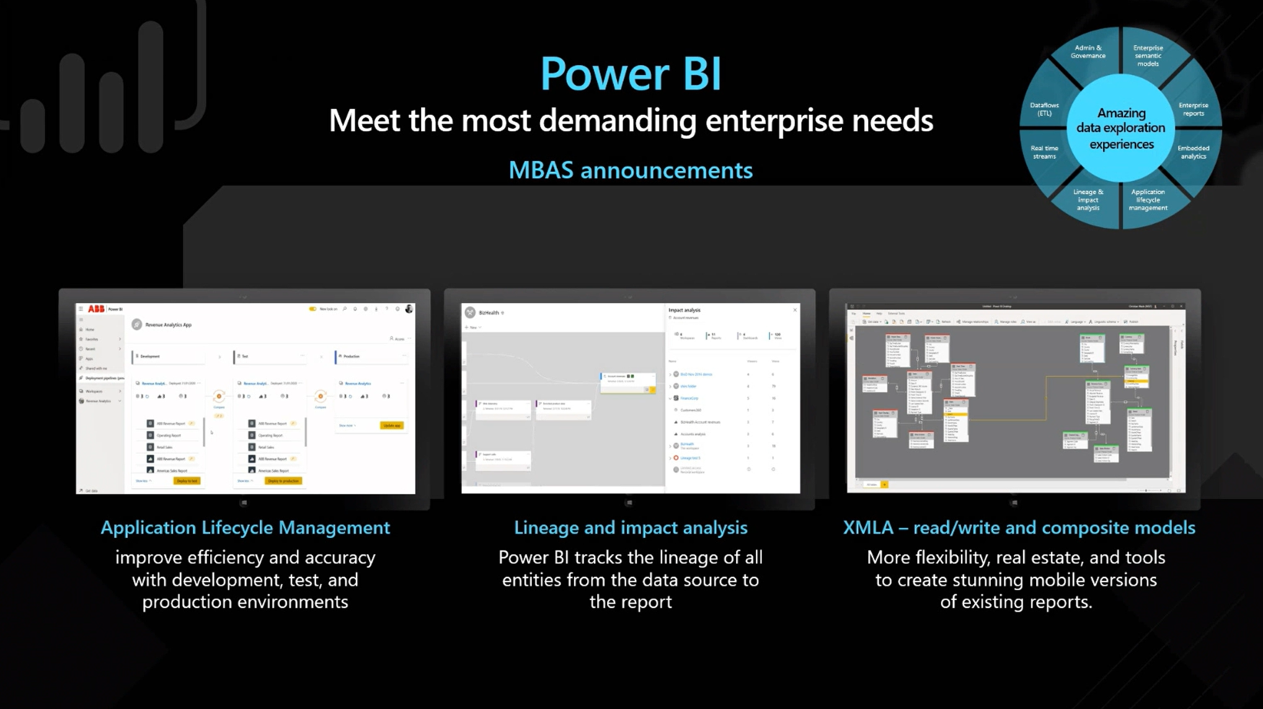

Slide 29
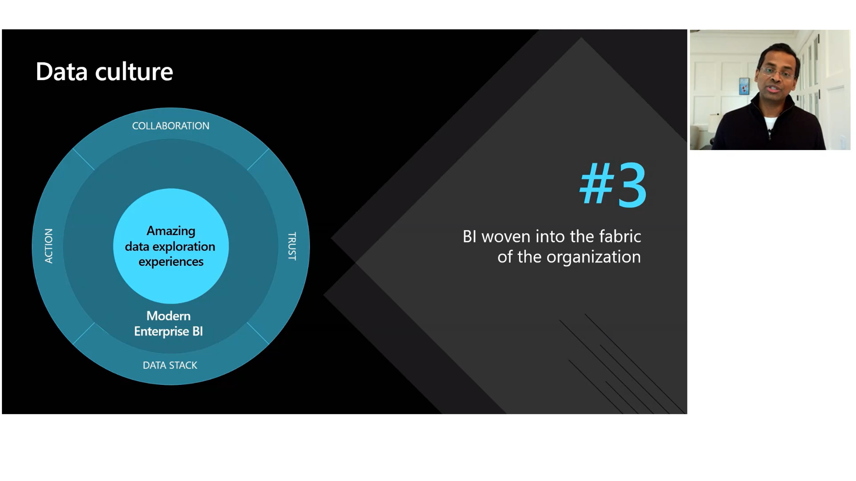

Slide 30
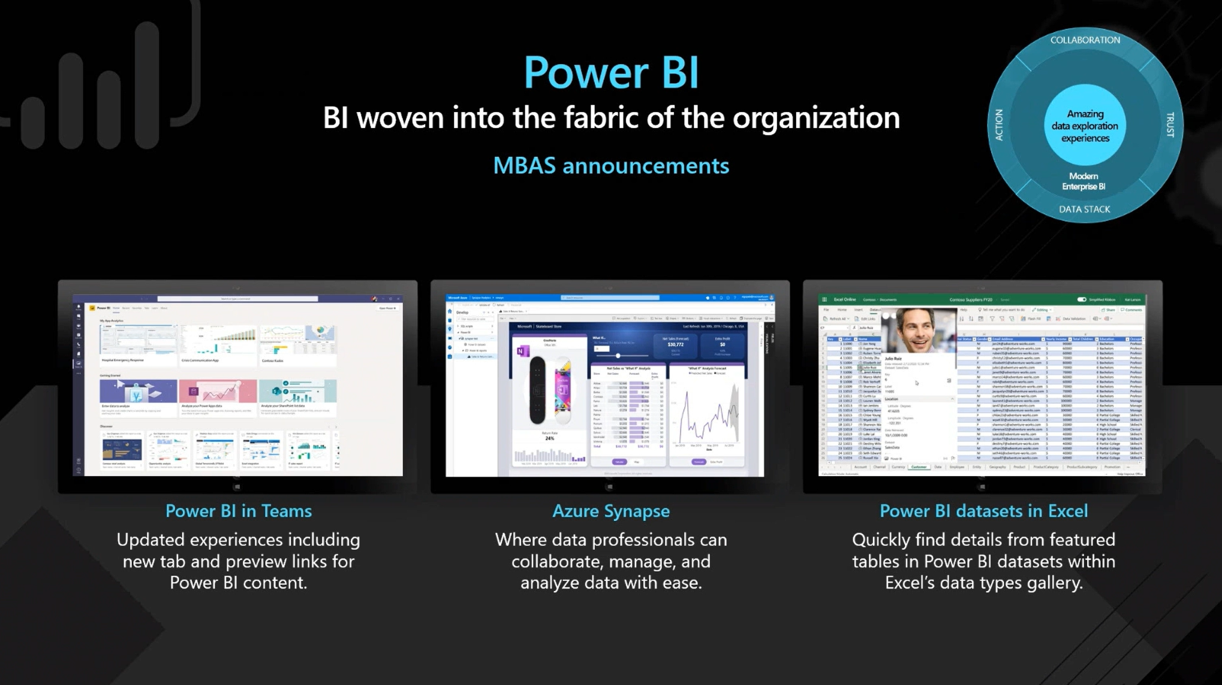

Slide 31
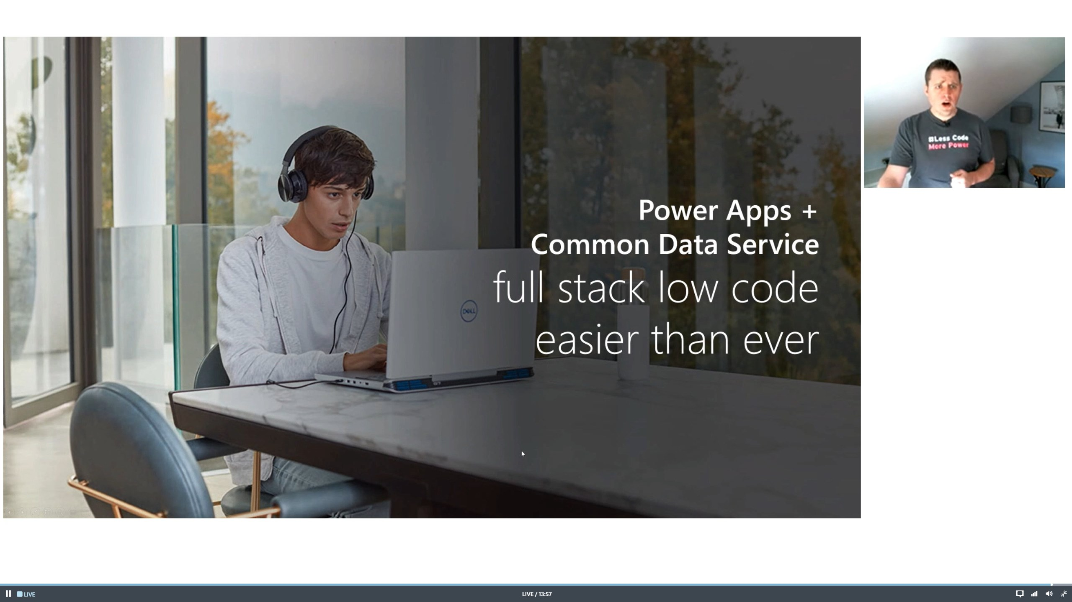

Slide 32
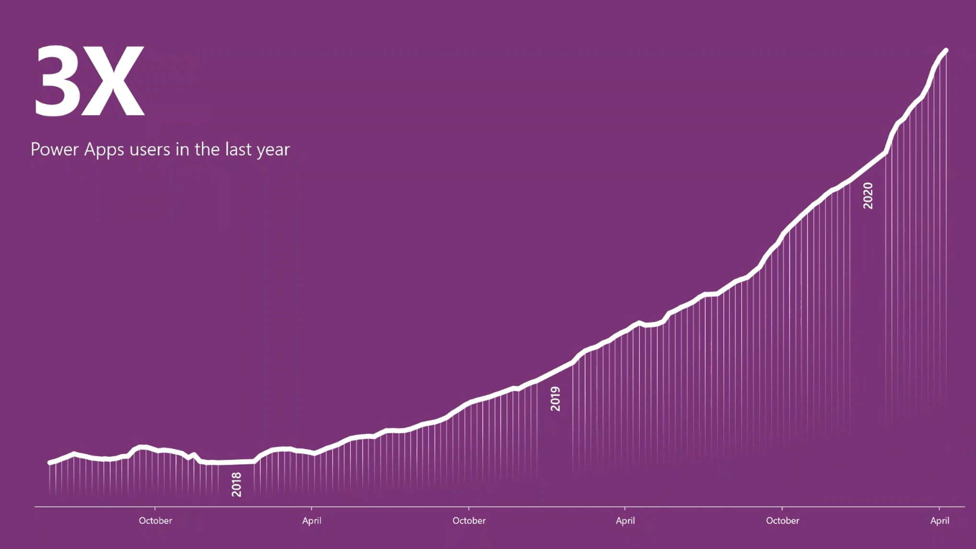

Slide 33
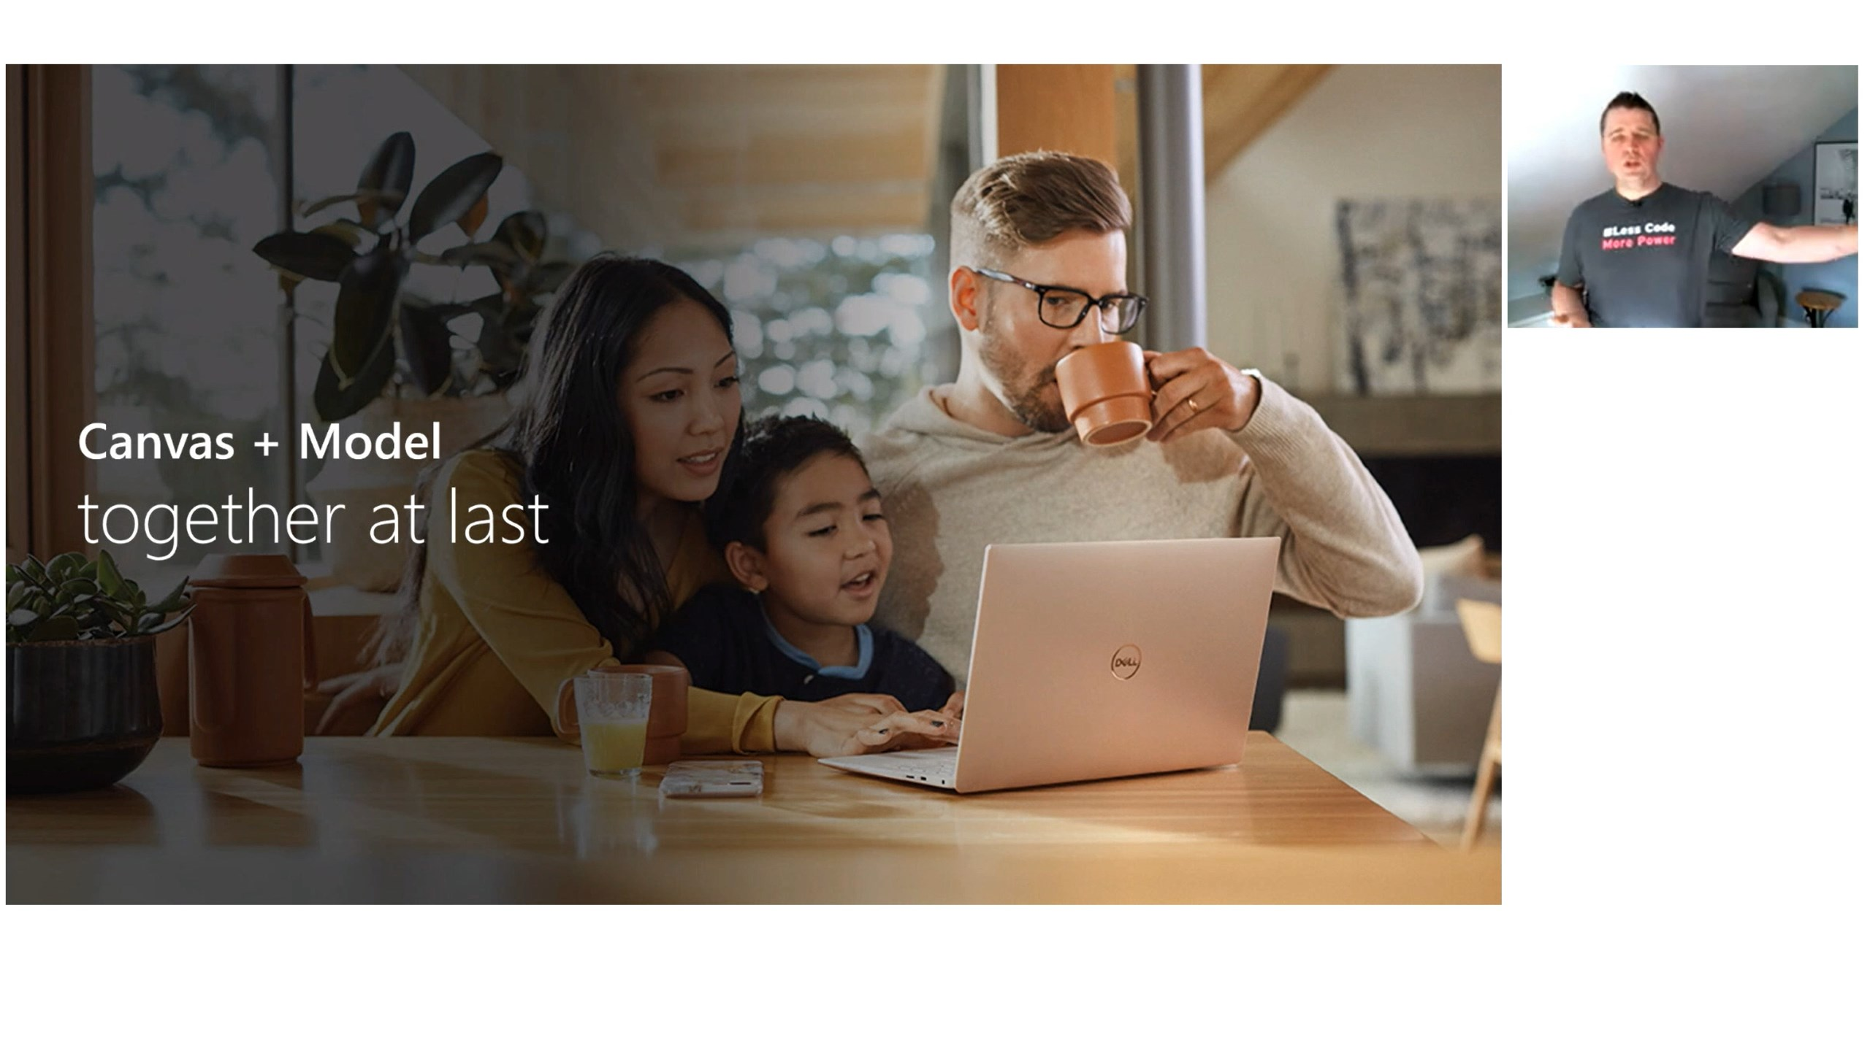

Slide 34
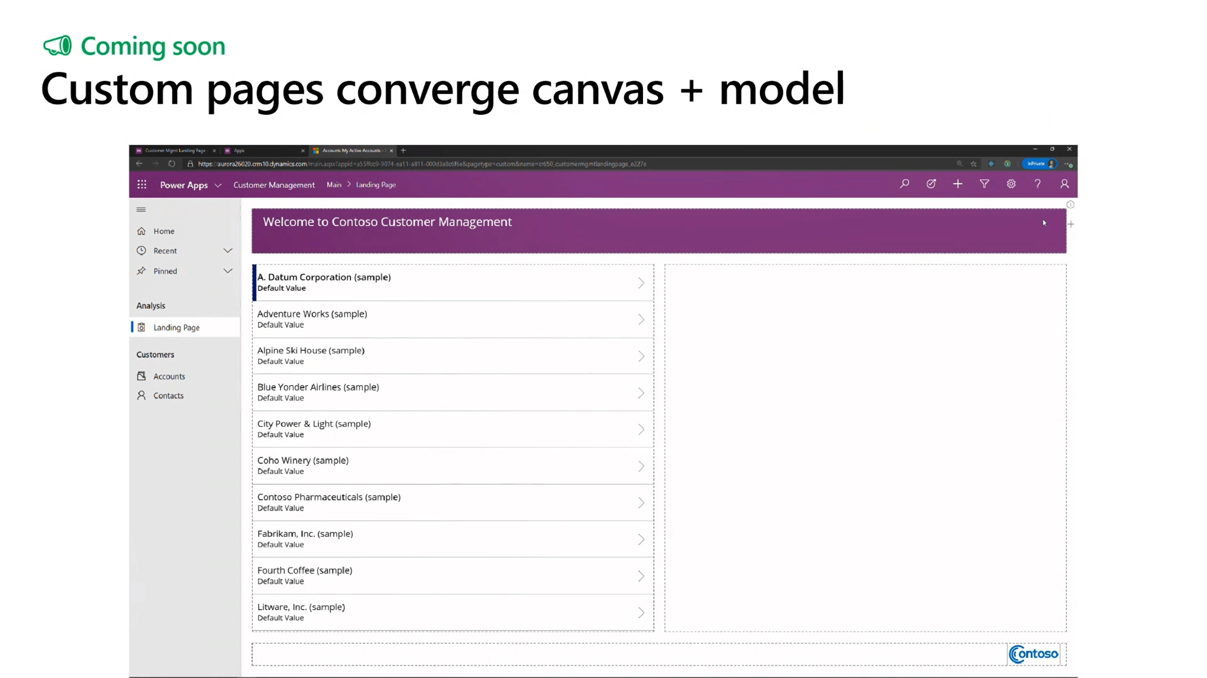

Slide 35
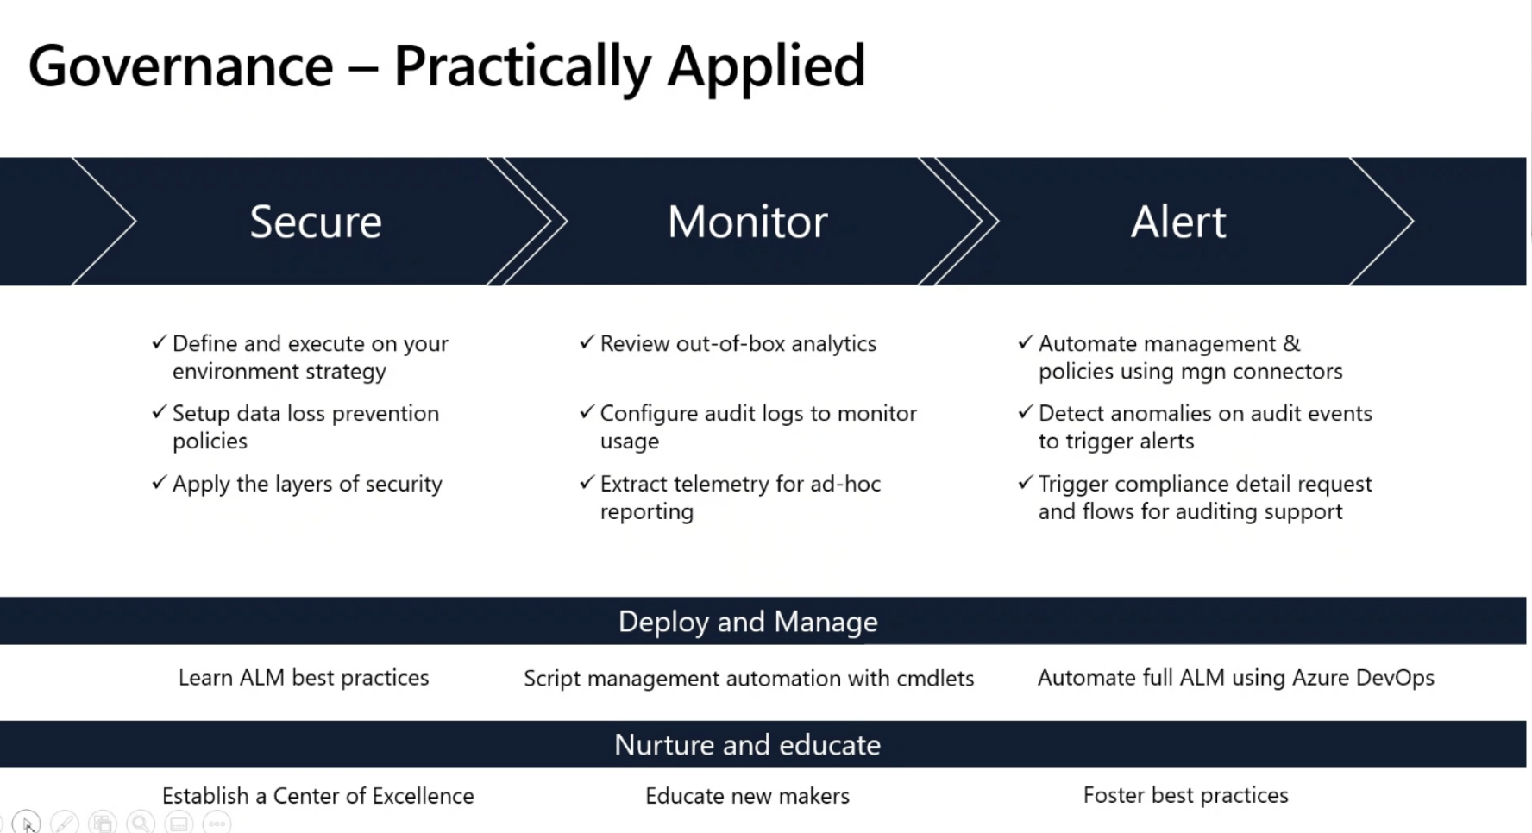

Slide 36
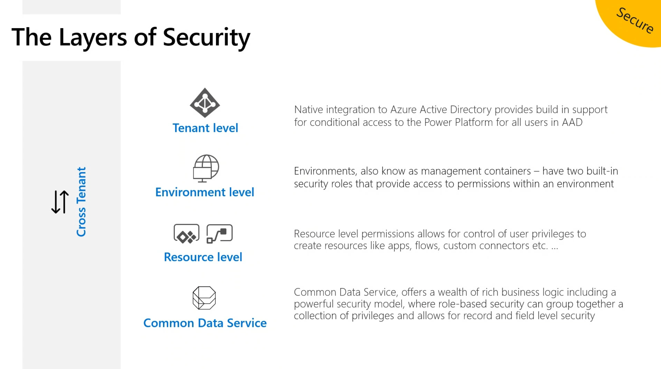

Slide 37
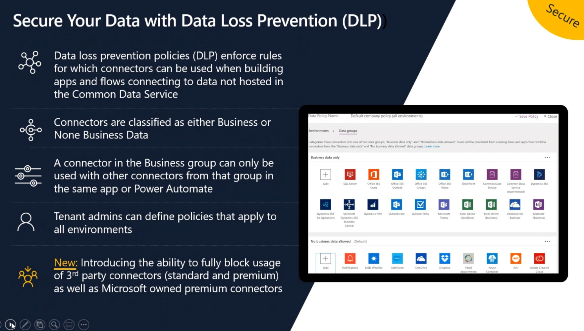

Slide 38
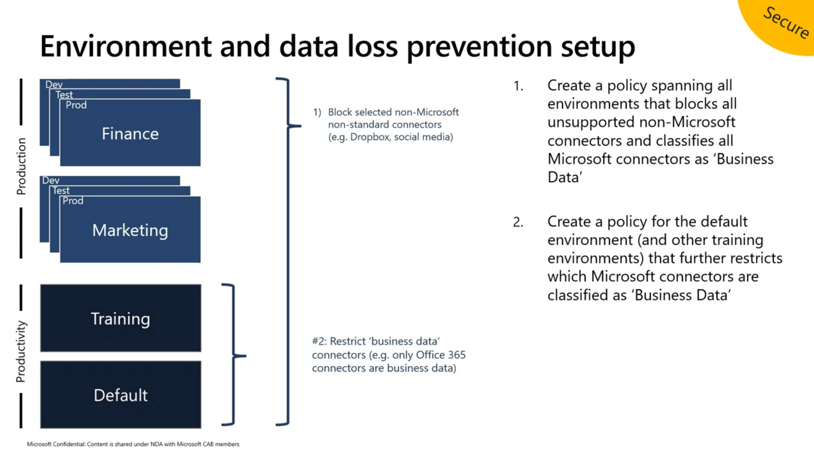

Slide 39
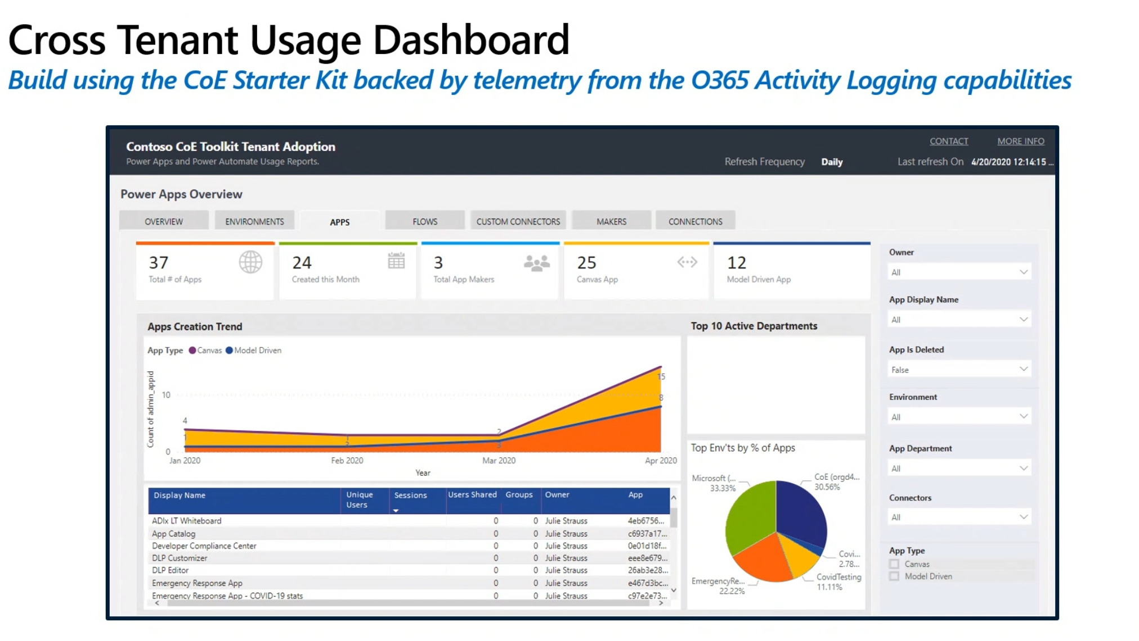

Slide 40
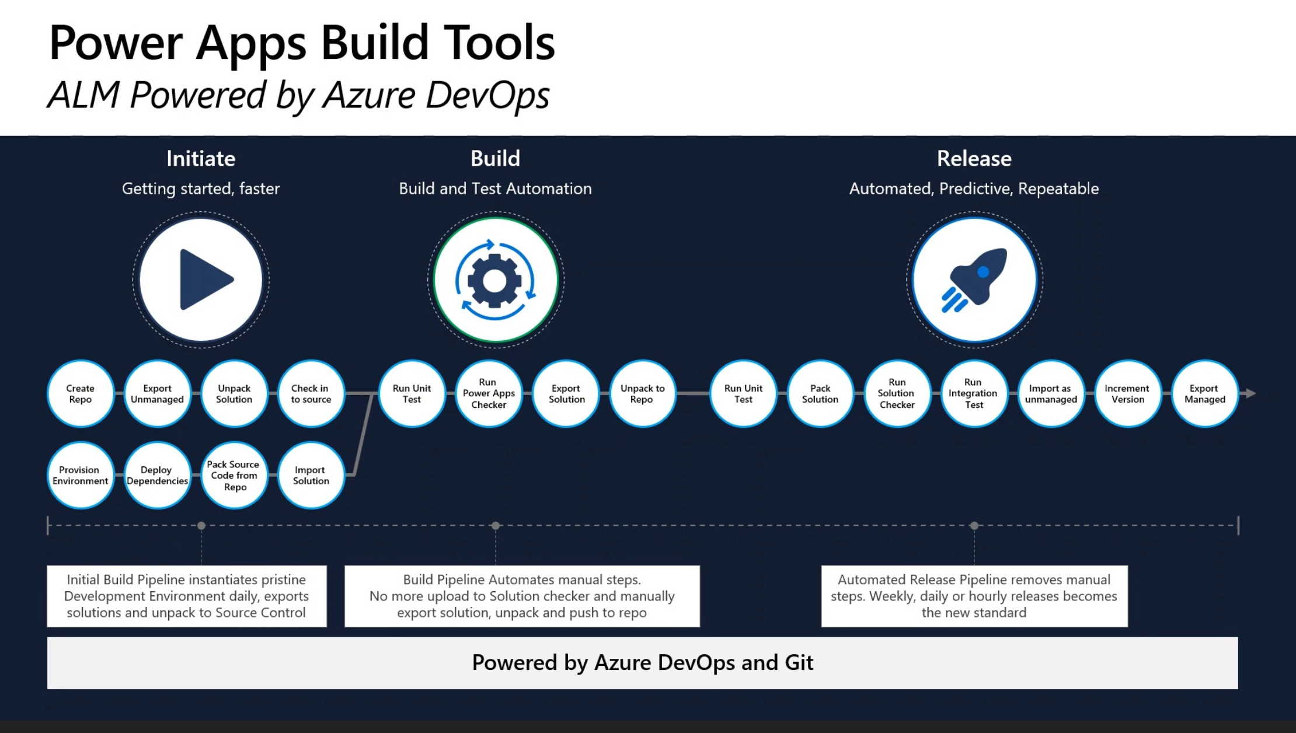

Slide 41
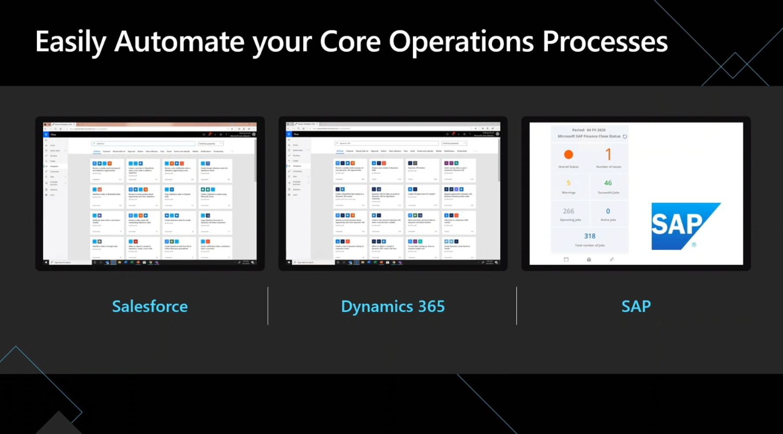

Slide 42
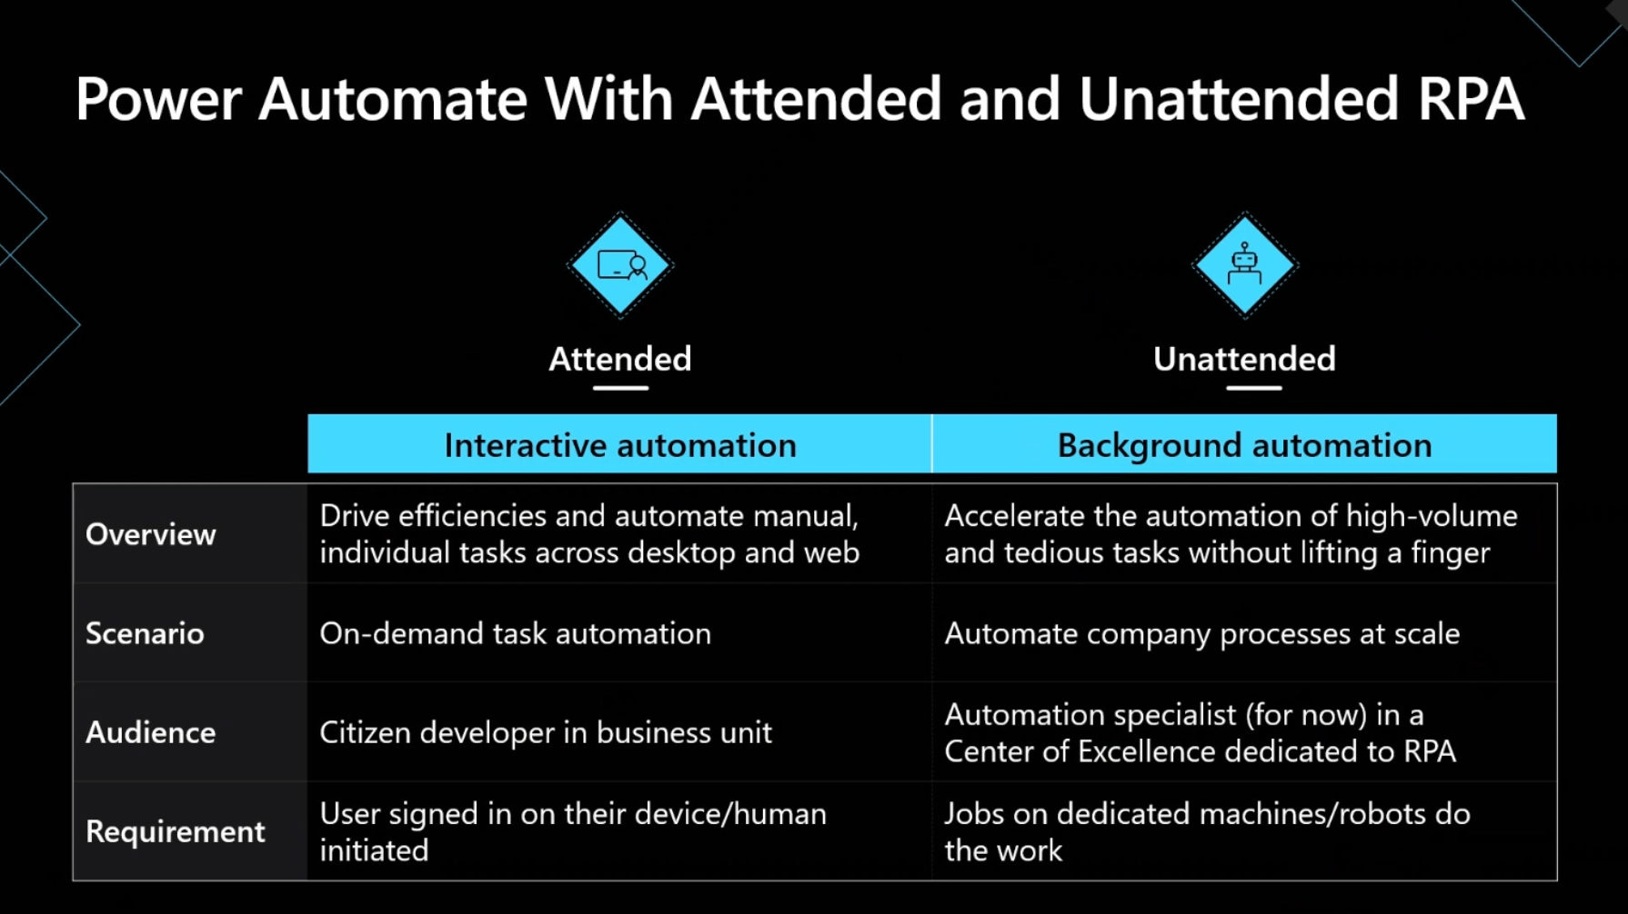

Slide 43


Slide 44
Teams

Slide 45
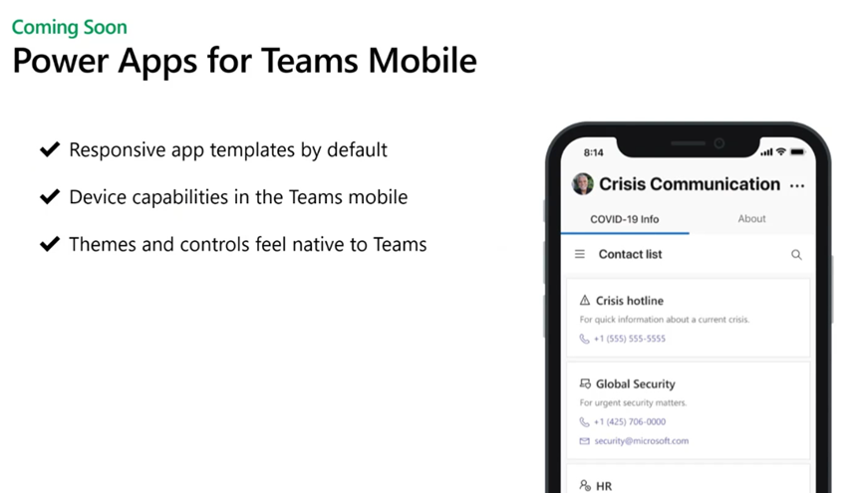

Slide 46
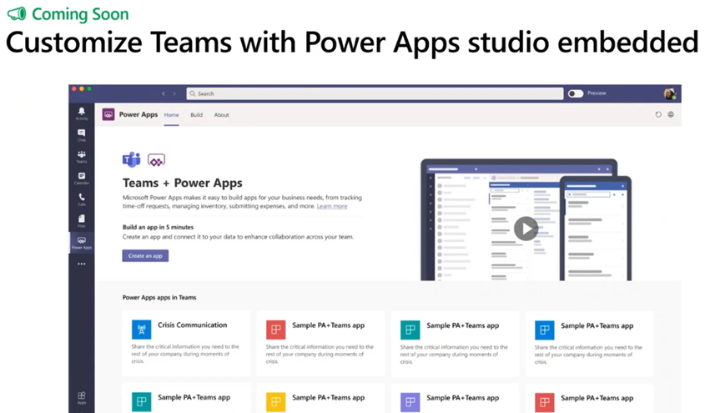

Slide 47
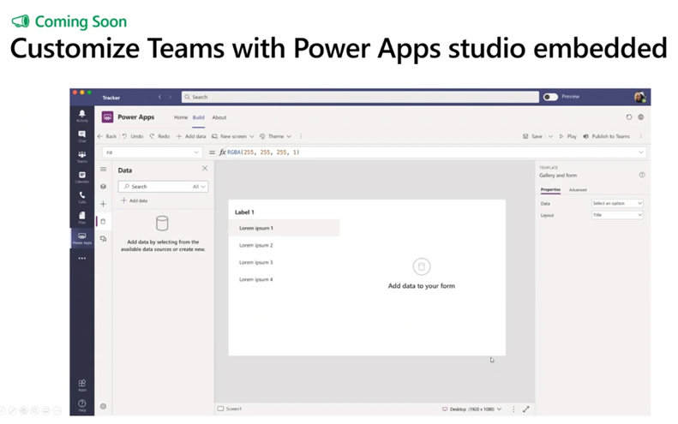

Slide 48
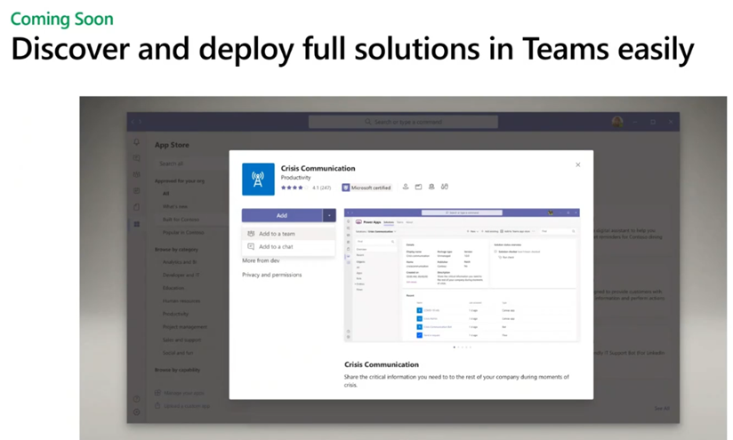

Slide 49
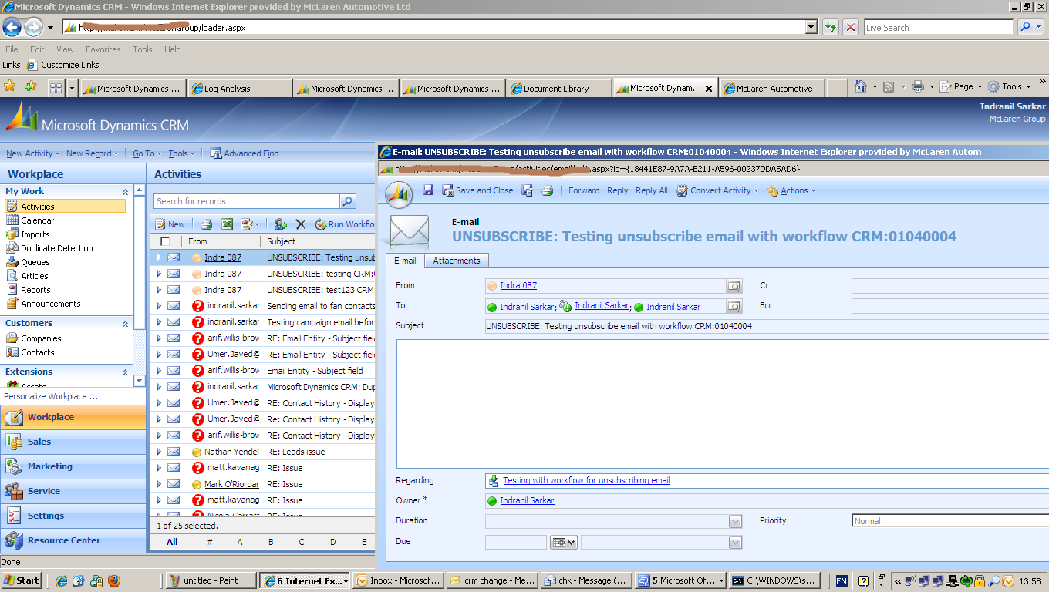
Customer Engagement
This Photo by Unknown author is licensed under CC BY-SA.

Slide 50
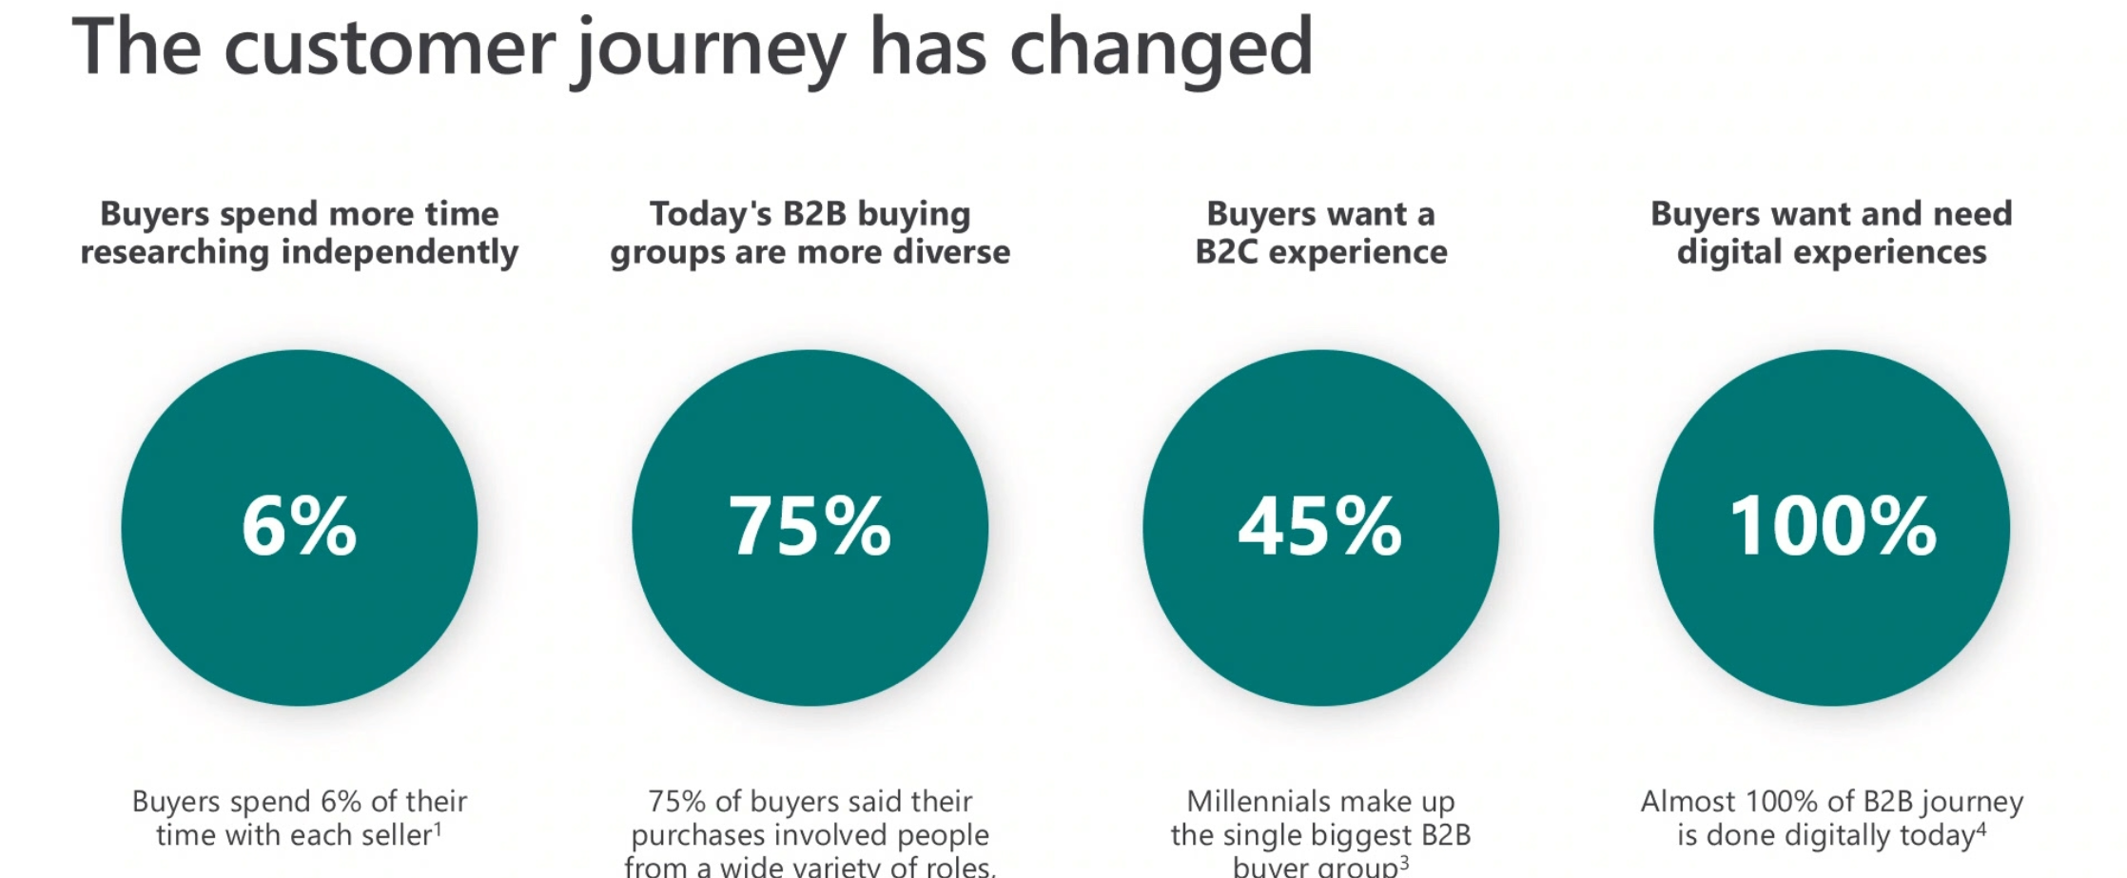
Sales Insights

Slide 51
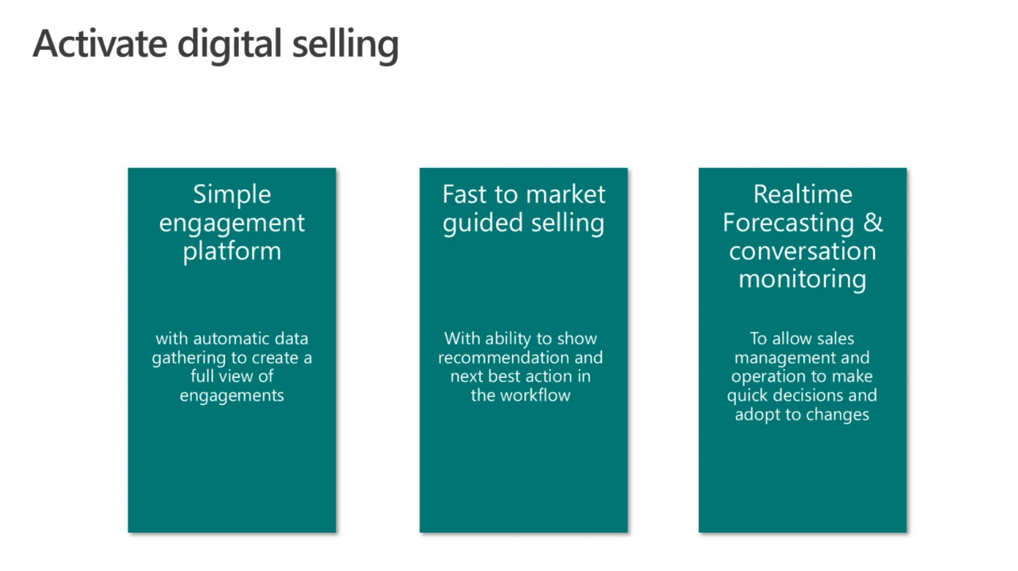

Slide 52
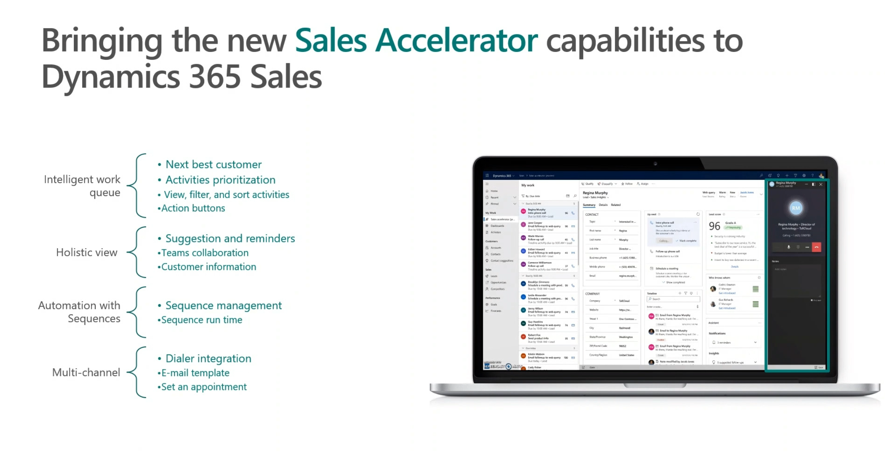

Slide 53
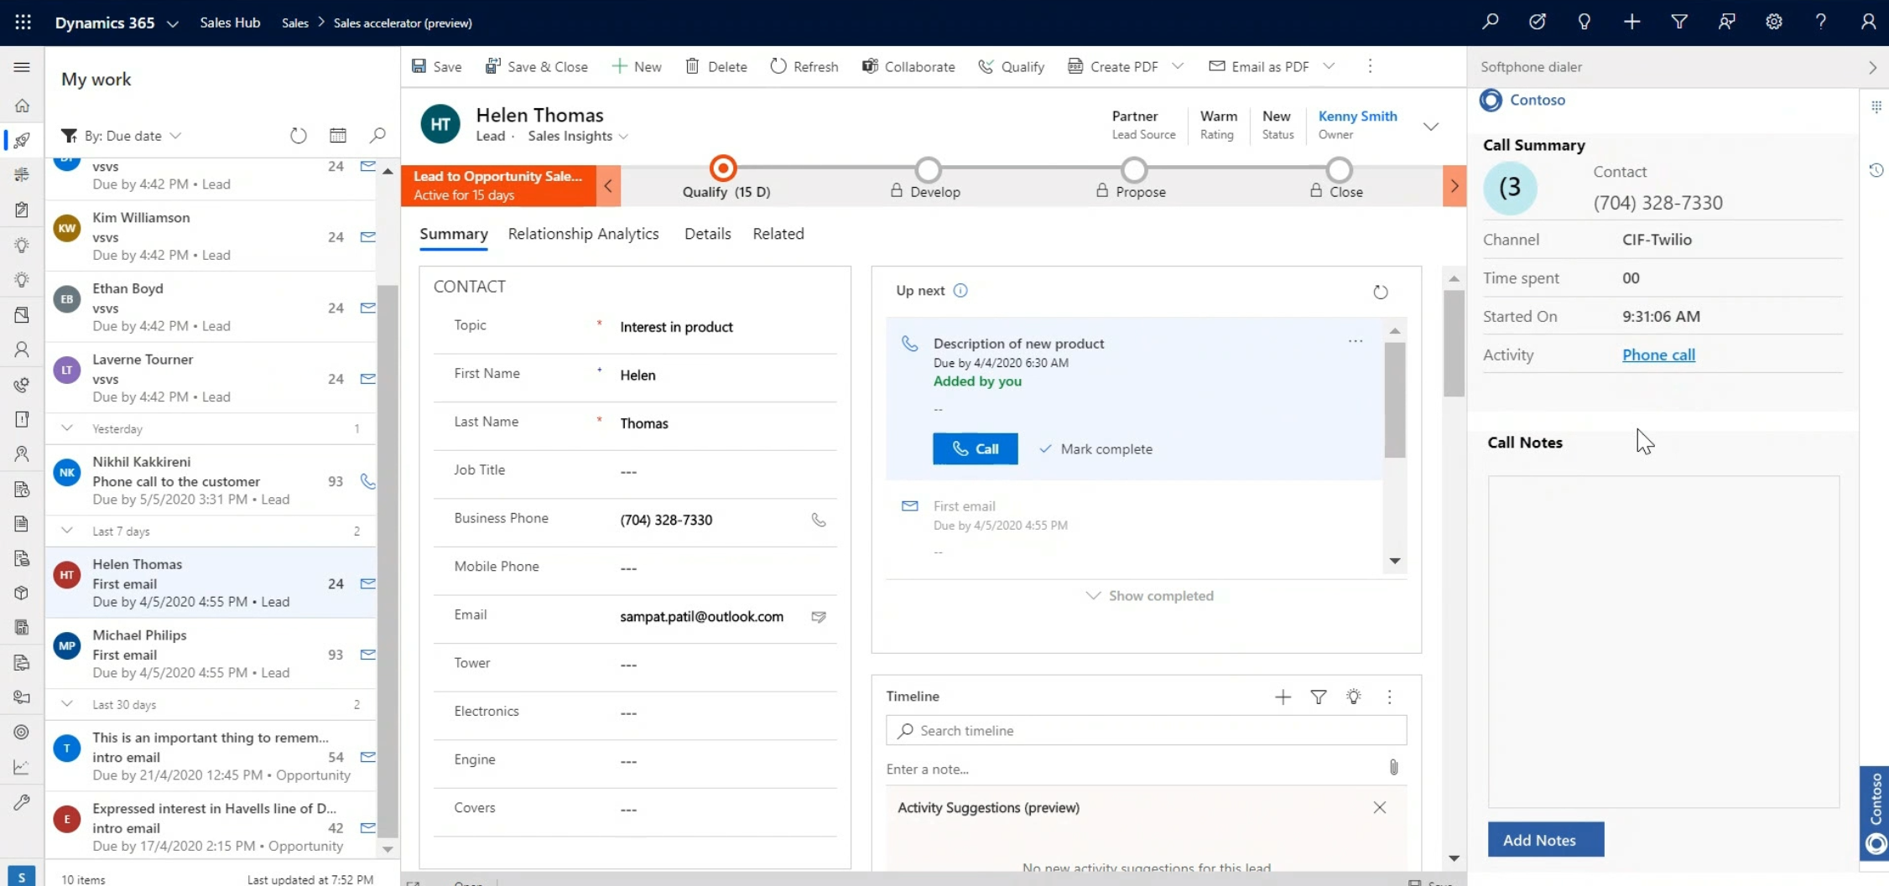

Slide 54


Slide 55


Slide 56


Slide 57


Slide 58


Slide 59


Slide 60


Slide 61
Finance & Operations

Slide 62


Slide 63


Slide 64


Slide 65


Slide 66


Slide 67


Slide 68


Slide 70
Kysymyksiä, kommentteja?

Slide 71

dynamics365.fi
info@dynamics365.fi

